Slide 1




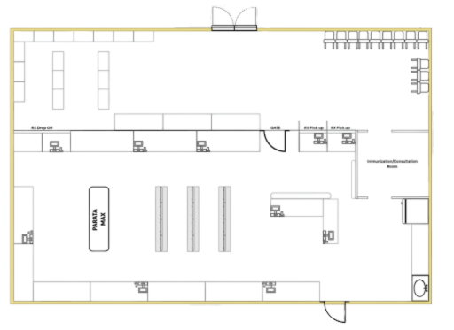
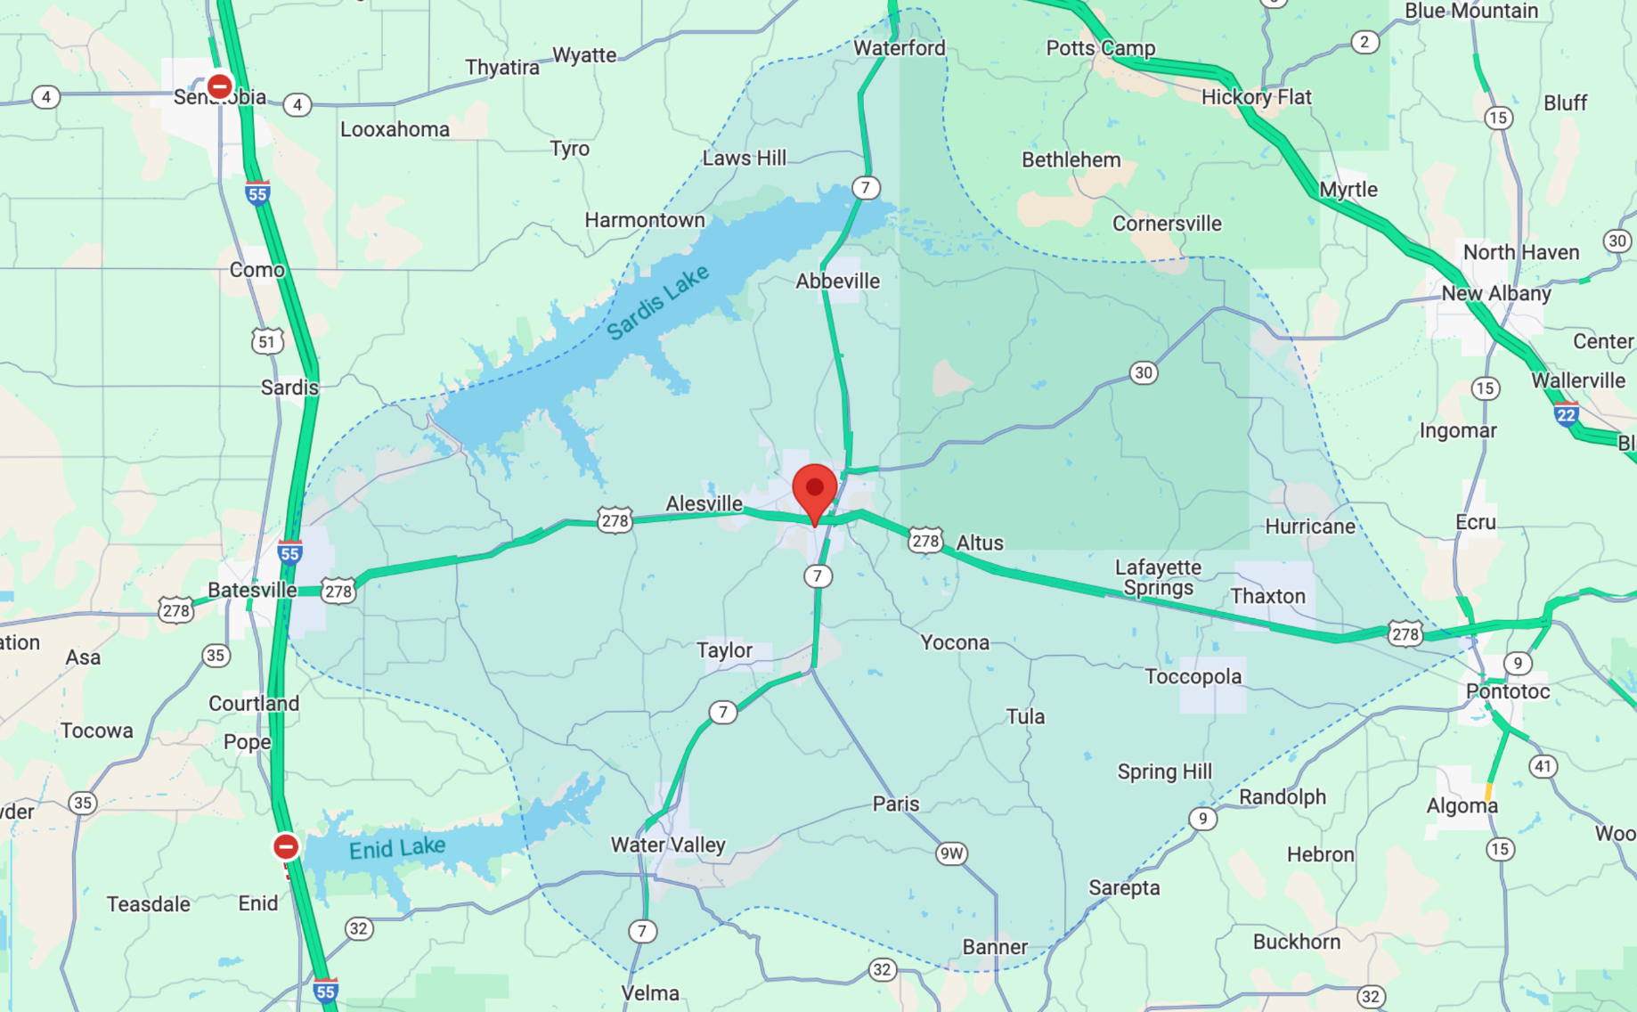
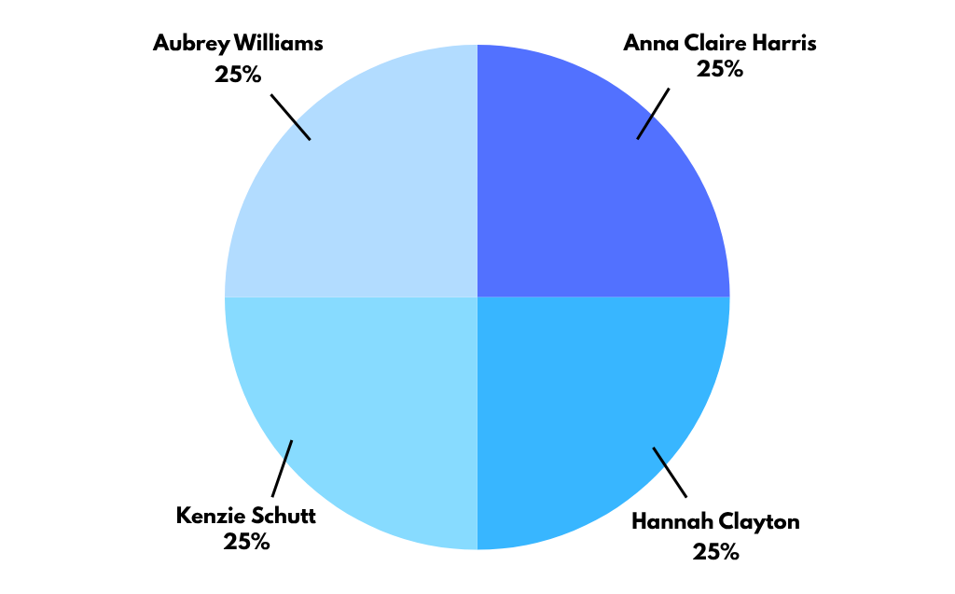
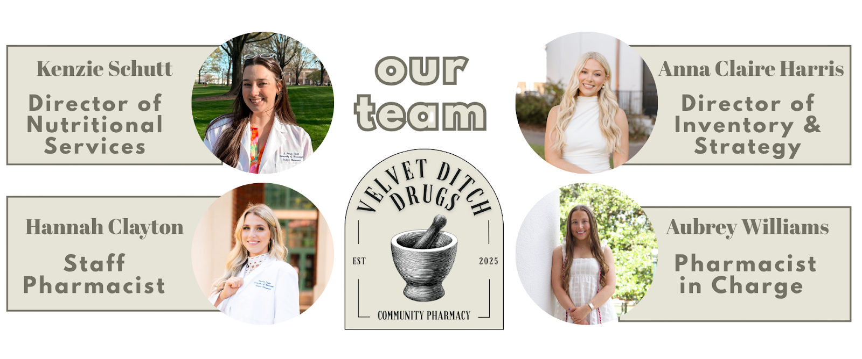
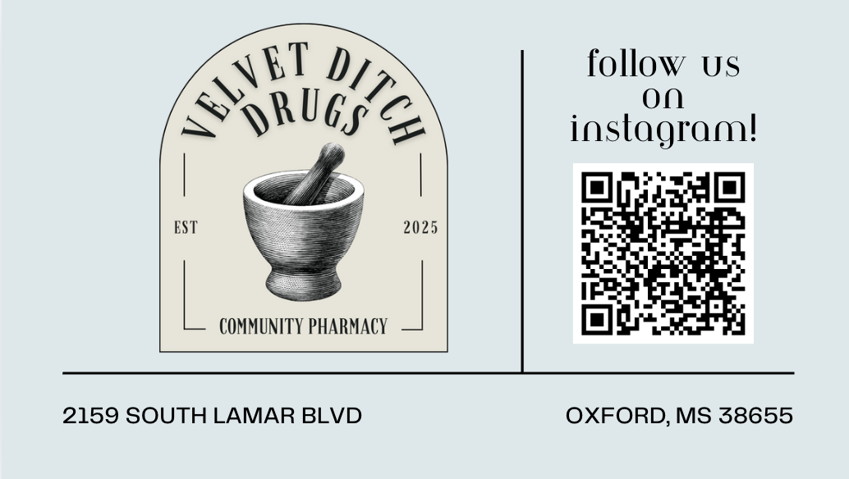
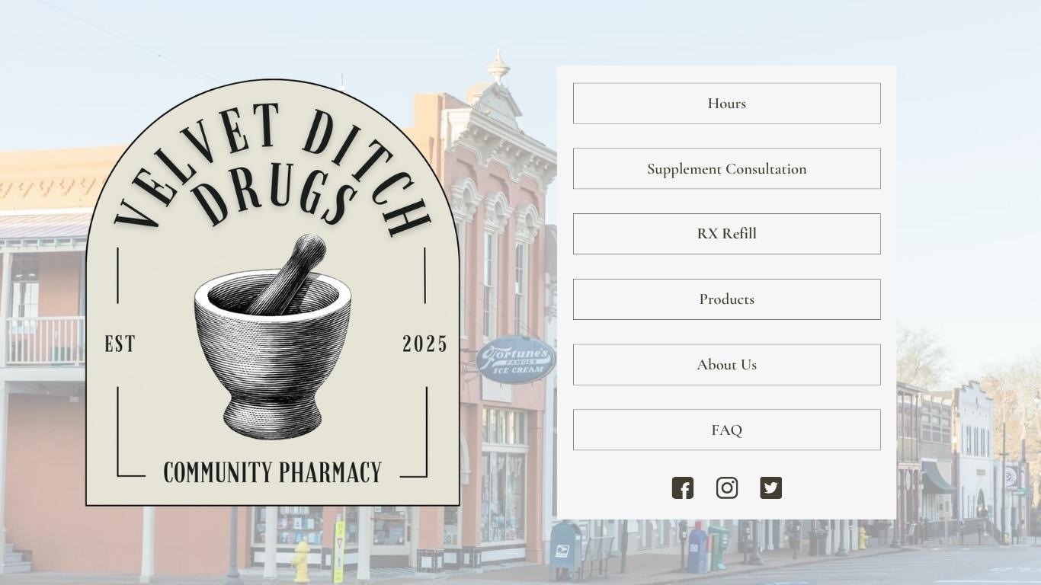
Velvet Ditch Drugs
Anna Claire Harris PharmD Candidate, Hannah Clayton PharmD Candidate, Karen “Kenzie” Schutt PharmD Candidate, Aubrey Williams, PharmD Candidate; Meagan Brown, PharmD, BCACP; Lindsey M. Rayborn, PharmD
MISSION
FINANCIAL SNAPSHOT
PURPOSE
OUR SOLUTION: A PHARMACY FOR MODERN CARE
Independent community pharmacies are uniquely positioned to bridge the gap between traditional healthcare and proactive wellness. Velvet Ditch Drugs was created to redefine the pharmacy experience by integrating personalized care, clinical expertise, and comprehensive wellness services under one roof. Our mission is to meet the evolving healthcare needs of Oxford, Mississippi, and continue improving patient outcomes, building lasting relationships, and creating a financially sustainable, community-centered pharmacy model.
Velvet Ditch Drugs expands beyond the traditional pharmacy model, offering an integrated services that address patient needs from prevention to chronic care management.
Core Pharmacy Services
Prescription dispensing & synchronization
Immunizations & adherence packaging
Personalized medication therapy management
Clinical & Wellness Services
One-on-one supplement & nutritional consultations
Body composition analysis using InBody technology
Chronic disease state consultations for diabetes, hypertension, & obesity
Retail & Lifestyle Offerings
Curated selection of OTC medications, skincare, & wellness products
High-quality supplements from brands like Thorne, Pure Encapsulations, & Nordic Naturals
Functional beverages, grab-and-go snacks, & travel essentials
Membership programs offering discounts, wellness screenings, & personalized perks
Velvet Ditch Drugs combines diverse revenue streams with conservative financial planning to ensure long-term sustainability and growth.
Category | Annual Revenue | Notes
Prescription Dispensing | $5,074,080 | 8,800 fills/month
OTC & Retail Sales | $100,000 | Wellness products, skincare, beverages
Clinical Services | $55,000 | Consultations, body composition, MTM
Total Revenue | $5,229,080
MISSION & VISION
Our Mission: At Velvet Ditch Drugs, we provide personalized, compassionate care to the Oxford, Mississippi community. As an independent pharmacy, we are committed to providing accessible, affordable healthcare while building lasting relationships with our customers. We offer expert guidance and ensure everyone receives the attention and service they deserve, supporting the health and well-being of our neighbors.
Our Vision: Velvet Ditch Drugs strives to be Oxford’s trusted health and wellness partner, delivering personalized care, expert guidance, and accessible medication solutions that enhance quality of life and foster a healthier community.
EBITDA: $698,968
Debt Service Coverage Ratio (DSCR): 4.14
Projected Cash Flow After Debt Service: $530,010 annually
IMPACT & FUTURE GOALS
STRATEGIC LOCATION ADVANTAGE
Velvet Ditch Drugs is more than a pharmacy, it’s a healthcare destination built around accessibility, innovation, and patient empowerment. Our future goals include:
Expanding clinical service offerings & wellness programs
Increasing patient engagement through personalized care plans
Strengthening partnerships with local providers & community organizations
Serving as a model for independent pharmacies seeking to evolve beyond traditional care
MARKET OPPORTUNITY
Our location at 2159 South Lamar Blvd. is designed for visibility, convenience, and clinical integration:
0.4 miles from Baptist Memorial Hospital North Mississippi
1.2 miles from major physician & specialty clinics
15,000+ vehicles pass our storefront daily
Positioned in the heart of Oxford’s healthcare center, Velvet Ditch Drugs is the most accessible independent pharmacy for patients seeking both prescription care and expanded wellness services.
We are proud to continue the legacy of G&M Pharmacy, a trusted healthcare destination that has faithfully served the Oxford community for decades. By building upon its strong reputation and deep-rooted patient relationships, Velvet Ditch Drugs aims to honor that history while evolving to meet the modern needs of our growing population.
Oxford, Mississippi is experiencing rapid population growth, increased healthcare demand, and a rising focus on preventative care, yet many pharmacies remain limited to traditional dispensing.
DISCLOSURES
The authors have nothing to disclose concerning possible financial or personal relationships with commercial entities that may have a direct or indirect interest in the subject matter of this presentation.
Within a five-mile radius of our location:
41,754 people live within the zip code 38655
134,727 prescriptions written monthly
402 prescribers
11 Retail Pharmacies: 7 independent, 4 chain
5 340b Entities
COMPETITIVE ADVANTAGE
Velvet Ditch Drugs stands apart from competitors by delivering an elevated pharmacy experience that combines clinical expertise with wellness-driven care. Our key differentiators include:
Comprehensive wellness services not offered by other local pharmacies
Membership model that builds long-term patient engagement & loyalty
Strategic partnerships with local healthcare providers & the University of Mississippi
Technology-enabled care to improve safety, efficiency, & adherence

