Slide 1
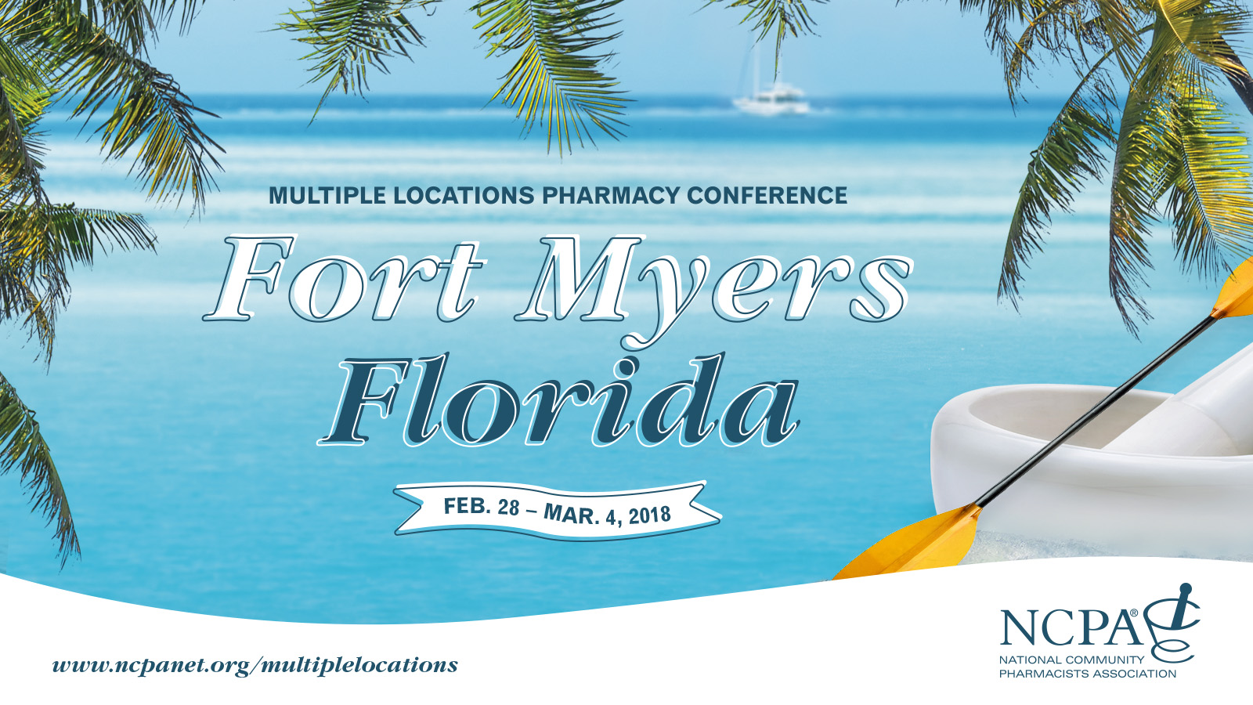

Slide 3
Understanding Amazon’s Challenge & Meeting It Head-on Randy P. McDonough, Pharm.D., M.S., BCGP, BCPS, FAPhA Co-Owner & Director of Clinical Services Towncrest, Solon Towncrest, & Towncrest Compounding Pharmacies Co-Owner, Innovative Pharmacy Solutions & Thrive Pharmacy Transformations

Slide 4
Disclosure
Randy McDonough declares no conflicts of interest or financial interest in any product or service mentioned in this program, including grants, employment, gifts, stock holdings, and honoraria.

Slide 5
Learning Objectives
Assess the available market intelligence on Amazon and its potential as a competitor to community pharmacy.
Discuss capitalizing on the competitive advantages inherent in the community pharmacy model.
Outline an outward-facing marketing strategy for the independent store to compete with big market players.

Slide 6
What’s In the News
This Is How Amazon Could Invade the Pharmacy Business
https://www.bloomberg.com/.../six-ways-amazon-could-upend-the-pharmacy-business
Anthem Partners With CVS Health To Launch New PBM
https://www.forbes.com/sites/.../anthem-partners-with-cvs-health-to-launch-new-pbm/
CVS to Buy Aetna for $69 Billion in a Deal That May Reshape the Health Industry
A version of this article appears in print on December 4, 2017, on Page A1 of the New York edition with the headline: Buying Aetna, CVS Envisions A Shift in Care.
Amazon, Berkshire Hathaway and JPMorgan Team Up to Try to Disrupt Health Care
A version of this article appears in print on January 31, 2018, on Page A1 of the New York edition with the headline: 3 Giants Form Health Alliance, Rocking Insurers.

Slide 7
With all this noise in the news… Opportunity or Threat?

Slide 8
What’s not being said?
Pharmacist-Patient relationships
Therapeutic relationships
Community Pharmacists are the most accessible providers
Ensuring that patients are achieving their therapeutic outcomes with safe and effective medications
This is OUR DOMAIN, OUR EXPERTISE, OUR TRAINING
We are uniquely educated and trained as the drug therapy expert
Quality patient care
It’s about VALUE not VOLUME
Inexpensive drugs can cause costly adverse events and even death if not appropriately monitored

Slide 9
Role(s) of the Community Pharmacist
Traditional role
Ensuring that the patient receives the right drug (as per prescription) with the correct directions (e.g. the right medication (based on Rx) is in the right bottle with the right directions)—volume driven.
The goal is an efficient and effective prescription dispensing process
Expanded role
Still need to have processes in place to ensure above role, in addition to—
Ensuring that the patient is on the most appropriate medication, that he/she is using it correctly, and that he/she is achieving his/her therapeutic outcome—value driven.
The goal is an improvement in patient care and patient outcomes

Slide 10
Value of Community Pharmacists
It’s about relationships

Slide 11
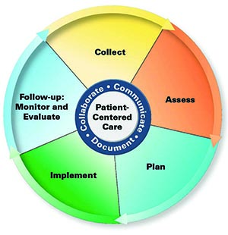
Moving Beyond Traditional Relationships

Slide 12
Continuum of Patient Care in Community Pharmacy
The Continuum of Patient Care

Slide 13
Changing Expectations of Patients/Caregivers
Collecting patient clinical information
From patients, caregivers, other healthcare providers, laboratories, EHRs, etc
Assessing clinical information
Has the patient achieved his/her therapeutic outcome?
Are the patient’s medications safe?
Are the patient’s medications effective?
Identifying medication-related problems
Making clinical interventions (resolving problems)
Communicating with patients and providers
Documenting pharmacists’ actions

Slide 14
Evolving the relationship with other providers
Community pharmacists need to become “interventionists”
Identifying and resolving drug therapy problems
Accessing information from other providers
Communicating patient clinical information to other providers
Making clinical recommendations
Documenting patient care activities

Slide 15
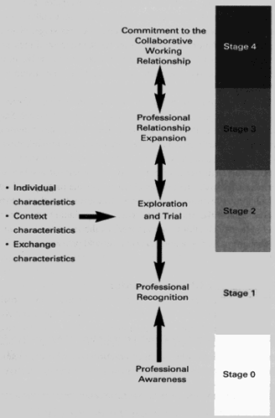
Developing Collaborative Working Relationships (CWRs)

Slide 16
Communicating with Prescribers

Slide 17
Challenges with this Evolving Role
Changing the paradigm of community pharmacy practice
Moving from a “retail” mentality (focus on product distribution)
Moving to a “patient-centered” mentality (focus on patient care and outcomes)
Essentially changing the “culture” of the practice—What is it that we do?
Creating a new mission statement that emphasizes this shift/culture change in the practice
New Mantra: Free Up the Pharmacists

Slide 18
Challenges with this Evolving Role
Evolve the operations of the pharmacy to ensure that pharmacists are freed up to provide patient care
Medication synchronization services
Technician-driven dispensing process
Tech-check-tech (if allowed)
Automation

Slide 19
Challenges with this Evolving Role
Changing on how we look at our Practices
The need for new resources
Slack resources
More techs?
More pharmacists?
The need to re-engineer the practice including the physical layout
Adding automation
Re-engineering workflow/patient care flow

Slide 20
Challenges with this Evolving Role
Changing on how we look at our Practices
Creating new revenue sources beyond the product
Cash-based services—patient-based
Incentive-based payments—payer-based
PBM
MTM incentives
Reduction of DIRs
Pay-for-performance—top 20% pharmacy
Health plans
Pay-for-performance
Achievement of clinical measure goals for patients considered costly to payer
Reduction in total cost of care
Collaboration with other providers/health organizations
Contracted work/Chronic Care Management (CCM)
Consultant
Other revenue sources
Wholesaler/Buying Groups

Slide 21
Challenges with this Evolving Role
Evolving the skills sets of pharmacists
What skills are required?
Therapeutic knowledge—foundation
Critical-thinking skills
Problem-solving skills
Decision-making skills
Interpersonal communication skills
Verbal and written
Collaboration and teamwork skills
Health coaching skills
Motivational interviewing skills
Documentation

Slide 22
Developing and Implementing Services that Generate Revenue
Wellness Center
Cholesterol screening
Blood glucose screening
A1c Screening
BP screening
Height and Weight
BMI
Specialized Focused
Mental Health
Wellness
Geriatrics
End of life/palliative care
Clinic Services
Med Check Program
Medication Adherence Program
Medication Synchronization Service
Super Synch Service
Influenza and Pneumococcal Vaccinations
Zostavax Vaccination
Tdap Vaccination
Pharmaceutical Case Management (PCM)
Medication Therapy Management (MTM)
Nursing Home Consulting
CPAP service/Education
Ostomy Consultations
Drug Information Service
Compounding
Employer based health screenings
Diabetic Shoes
Compression Stockings

Slide 23
Practice Change Impact

Slide 24
Leads to New Opportunities

Slide 25
Summary of Our Findings
Regular high quality pharmacists care helps patients get the best outcomes from their medications
Collaboration (collaborative working relationships) with physicians, health-systems, and other stakeholders is important
Management needs to support pharmacist-patient interactions
There is a need for resources to deliver this level of care
IT IS NOT the “strip-down” model of practice
This enhanced model of pharmacists’ care does require new payment models
Increased costs to the pharmacy

Slide 26
Conclusion
Pharmacy innovation is important for the future viability of the profession.
Pharmacists need to be aware of pharmacy performance measures
Pharmacists need to implement patient care processes that positively impact therapeutic outcomes
Clinical performance means access to patient lives and new payment strategies
The future

Slide 27
Preparing for Amazon
It takes offering services that transcend traditional pharmacy services
and telling patients and potential patients.
Next up, Karen Sulprizio with tips on how to get your message out

Slide 28
Randy P. McDonough, Pharm.D., M.S., BCGP, BCPS, FAPhA Co-Owner & Director of Clinical Services Towncrest, Solon Towncrest, & Towncrest Compounding Pharmacies Co-Owner, Innovative Pharmacy Solutions & Thrive Pharmacy Transformations mcdonough@towncrest.com 319-337-3526 (Work) 319-430-4476 (Cell)

