Slide 3
50th Annual NCPA Congressional Pharmacy Summit April 11, 2018

Slide 4
NCPA Legislative Briefing Karry La Violette Vice President, Government Affairs and Advocacy

Slide 5
Disclosure
Karry La Violette declares no conflicts of interest or financial interest in any product or service mentioned in this program, including grants, employment, gifts, stock holdings, and honoraria.

Slide 6
Learning Objectives
Discuss the community pharmacy legislative priorities being pursued by NCPA in 2018.
Discuss advocacy efforts to address DIR fees, and other PBM programs.
Describe key features of the Medicare Part D Rule for the 2019 plan year.
Relate best practices for communicating with elected representatives to advance your legislative goals.

Slide 7
The strength of our numbers NCPA represents the interests of America's community pharmacists, including the owners of more than 22,000 independent community pharmacies. Together our members represent an $80 billion health care marketplace and employ more than 250,000 people.

Slide 8
NCPA Advocacy Team in Washington

Slide 9
NCPA’s message getting through…
HHS Sec. Azar recent comments on administration focus on discounts PBMs receive
Council of Economic Advisers calls out PBM market concentration
Three senators ask questions about PBMs during hearing for FTC Commissioners
NCPA helped suppress opposition response to CMS pharmacy DIR letter
Quoted in New York Times, Washington Post, American Prospect (which later wrote “The Corporate Scam That Even Trump Opposes: PBMs“), NBC Nightly News with Lester Holt (October), local stations in Richmond (NBC) and New Orleans (Fox)

Slide 10
“What CVS is doing to mom-and-pop pharmacies in the US will make your blood boil”
March 30, 2018
CVS Caremark, the in-house pharmacy benefit manager for CVS, has been accused of squeezing small pharmacies, driving some out of business.
Lawmakers in Arkansas and Ohio have been quick to pass laws designed to end this by demanding higher transparency or regulatory oversight.
CVS is also trying to buy up small pharmacies, which is much easier to do if they're going out of business.

Slide 11
State Government Affairs
NCPA assistance to states
Currently working with 35 states on legislative and regulatory issues
Comprehensive PBM reform, patient protections, Medicaid reforms, scope of practice and prescriptive authority
6 NCPA-assisted bills signed into law, 3 additional bills sent to governor
Great leadership by state partners this session

Slide 12
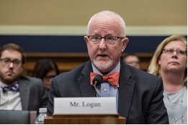
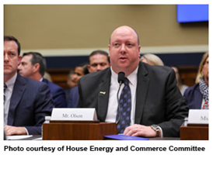
NCPA Being Heard on Capitol Hill
12/13/17: NCPA CEO Doug Hoey testifying at House E&C Committee Drug Supply Chain Hearing
2/28/18: Pharmacy Owner Richard Logan testifying on behalf of NCPA at House E&C Subcommittee on Health Opioid Crisis Hearing
1/30/18: Pharmacy Owner Jake Olson testifying on behalf of NCPA at House E&C Subcommittee on Health Compounding Hearing

Slide 13
2018 NCPA Advocacy Priorities
1. Ban on Retroactive Pharmacy DIR Fees (H.R. 1038 / S. 413 )
2. MACs/Generic Drug Reimbursement (H.R. 1316)
3. Pharmacy Choice in Medicare Part D/Preferred Networks (H.R. 1939 / S. 1044)

Slide 14
DIR Fees – H.R. 1038 / S. 413
“The Improving Transparency and Accuracy in Medicare Part D Drug Spending Act”
Bans retroactively reducing payment on clean claims submitted by pharmacies under Medicare Part D
Increases transparency in Medicare
Lowers cost sharing levels for seniors
Reduces the program’s catastrophic costs (DIR up from $8.7B to $23.6B)
Saves $3.4B/10 years, according to Wakely Group score
Broad industry support shown via NCPA-generated sign-on letter resulting in over 120 signatories: Grocers, Health Systems, Regional Chains, Specialty, State Assoc.’s, Wholesalers

Slide 15
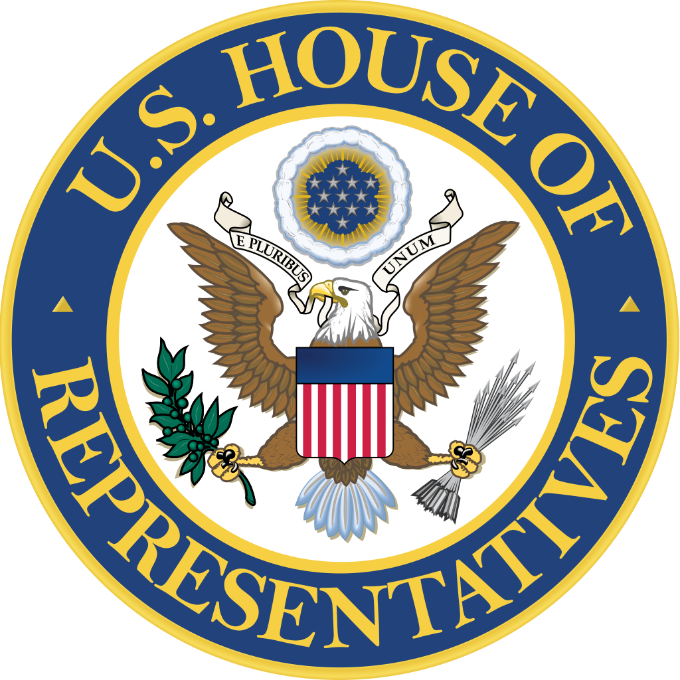
DIR Fees – H.R. 1038
67 Co-Sponsors
Introduced by Reps. Morgan Griffith (R-VA) and Peter Welch (D-VT) with
Bruce Babin (R-TX), Lou Barletta (R-PA), Rod Blum (R-IA),
Buddy Carter (R-GA), Doug Collins (R-GA), Rick Crawford (R-AR),
Lloyd Doggett (D-TX), Drew Ferguson (R-GA), Bob Goodlatte (R-VA),
Gregg Harper (R-MS), Walter Jones (R-NC), Thomas Massie (R-KY),
Martha Roby (R-AL), Cathy McMorris Rodgers (R-WA), Phil Roe (R-TN), and
Pete Sessions (R-TX)

Slide 16
DIR Fees – S. 413
13 Co-Sponsors
Introduced by Sens. Shelley Moore Capito (R-WV) and Jon Tester (D-MT)
with John Boozman (R-AR), Tom Cotton (R-AR), Chuck Grassley (R-IA),
Heidi Heitkamp (D-ND), James Lankford (R-OK), and Roger Wicker (R-MS)

Slide 17
NCPA Part D Rule Efforts
NCPA supported CMS' recommendation that PBMs be required to account for pharmacy price concessions (DIR) at point of sale, rather than retrospectively
CMS in Final Rule asserted its authority to propose a future rule that would shift pharmacy price concessions (DIR) to point of sale
CMS' recognition of the need to address the issue at all is largely the result of NCPA's forceful lobbying efforts and input
NCPA meetings with CMS, HHS, and White House Office of Management & Budget (OMB)

Slide 18
NCPA Part D Rule Efforts by the #’s
1,000 +: Pharmacies that responded to NCPA to submit comments to CMS
120: Pharmacy groups and stakeholders signed onto NCPA led letter to CMS
80: House members signed onto NCPA led letter to CMS
21: Senators signed onto NCPA led letter to CMS
9: Consumer groups signed onto NCPA led letter to CMS

Slide 19
Generic Drugs & MACs – H.R. 1316
“The Prescription Drug Price Transparency Act,” H.R. 1316
Brings clarity to generic payments in Medicare, TRICARE, FEHB
Protects taxpayer dollars in federal health programs
Encourages cost-saving generics whenever appropriate
Supports access to independent community pharmacies
Protects patient choice of pharmacy
44 Co-Sponsors: Introduced by Reps. Doug Collins (R-GA) and Dave Loebsack (D-IA) with Brian Babin (R-TX), Rod Blum (R-IA), Buddy Carter (R-GA), John Duncan, Jr. (R-TN), Cathy McMorris Rodgers (R-WA), and John Sarbanes (D-MD)

Slide 20
Pharmacy Choice in Medicare – H.R. 1939 / S. 1044
“The Ensuring Seniors Access to Local Pharmacies Act”
Previously the “Any Willing Pharmacy” bill
Gives seniors more access to discounted copays for prescription drugs at their pharmacy of choice
Allows pharmacies in medically underserved areas to participate in Medicare preferred pharmacy networks if they accept the drug plan’s terms and conditions
25 Co-Sponsors in the House, Introduced by Reps. Morgan Griffith (R-VA) and Peter Welch (D-VT)
4 Co-Sponsors in the Senate, Introduced by Sens. Shelley Moore Capito (R-WV) and Sherrod Brown (D-OH)

Slide 21
Opioid Abuse
NCPA Recommended Solutions
Expand Consumer Access to Naloxone with pharmacists participating in wider distribution of naloxone, including allowing pharmacists to directly prescribe
Establish Limits on Maximum Day Supply for Certain Controlled Substances
Expand Electronic Prescribing of Controlled Substances (EPCS)

Slide 22
Other Topics
Provider Status – “The Pharmacy and Medically Underserved Areas Act,” S. 109 / H.R.592
Compounding – “The Preserving Patient Access to Compounded Medications Act,” H.R. 2871
TRICARE – Senate/House sign on letters asking DoD to form a stakeholder working group to improve TRICARE access to pharmacies
Prescription Drug Prices
“Gag Clause” Legislation – S. 2553, S. 2554, H.R. 5343
Notes:
S. 2553: Stabenow, Collins, Wyden, Cassidy, McCaskill, Barrasso- allows pharmacists to tell Part D beneficiaries if cash price is lower than through their insurance coverage
S. 2554: Collins, McCaskill, Barrasso, Stabenow, Cassidy- applies S. 2253 to ACA exchanges and ERISA plans
H.R. 5343: Carter (GA), Welch, Griffith, Scott (GA)), McMorris Rodgers, Collins (GA)- grants pharmacists the ability to make patients aware if there is a lower cost option

Slide 23
What you’re walking into…
Be prompt and flexible...
If the member of Congress is unavailable or late, convey points to the staffer as if they were the member.
Call the office to communicate if you are running late. Do not be surprised or offended if your meeting takes place in a hallway.
Be engaged…
Distribute and collect business cards. Follow up with a thank you note reiterating points you made in the meeting; develop a relationship with them; and invite them to visit your pharmacy.

Slide 24
How to talk about our issues
Keep it simple
Avoid industry jargon and acronyms
Relate it to patients
Share examples to illustrate solutions
Understand limits on staff awareness of independent pharmacy
Do your homework: Thank those already co-sponsoring legislation, are there others in their delegation co-sponsoring?

Slide 25
Asks for House Visits
Co-Sponsor H.R. 1038, “The Improving Transparency and Accuracy in Medicare Part D Drug Spending Act;” thank them if they are already a co-sponsor
Co-Sponsor H.R. 1316, “The Prescription Drug Price Transparency Act;” thank them if they are already a co-sponsor
Co-Sponsor H.R. 1939, “The Ensuring Seniors Access to Local Pharmacies Act;” thank them if they are already a co-sponsor

Slide 26
Asks for Senate Visits
Co-Sponsor S. 413, “The Improving Transparency and Accuracy in Medicare Part D Drug Spending Act;” thank them if they are already a co-sponsor
Co-Sponsor S. 1044, “The Ensuring Seniors Access to Local Pharmacies Act;” thank them if they are already a co-sponsor

Slide 27
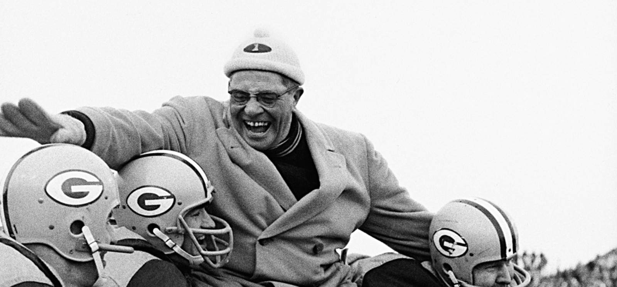
“There’s only one way to succeed in anything, and that is to give it everything. I do, and I demand that my players do.”
Vince Lombardi

Slide 28
Karry La Violette Vice President, Government Affairs & Advocacy karry.laviolette@ncpanet.org 703-683-1180 Twitter: @KarryLaViolette

Slide 29
Medicare Part D and Drug Accessibility
Ronna Hauser, PharmD
Vice President of Pharmacy Affairs, NCPA
Madelaine Feldman, MD, FACR
Vice President, Council of State Rheumatology Organizations
John Schall, MPP
Chief Executive Officer, Caregiver Action Network
Joel White
President, Horizon Government Affairs

Slide 30
Disclosures
Ronna Hauser declares no conflicts of interest or financial interest in any product or service mentioned in this program, including grants, employment, gifts, stock holdings, and honoraria.
Madelaine Feldman declares no conflicts of interest or financial interest in any product or service mentioned in this program, including grants, employment, gifts, stock holdings, and honoraria.
John Schall declares no conflicts of interest or financial interest in any product or service mentioned in this program, including grants, employment, gifts, stock holdings, and honoraria.
Joel White declares no conflicts of interest or financial interest in any product or service mentioned in this program, including grants, employment, gifts, stock holdings, and honoraria.

Slide 31
Medicare Part D & Drug Accessibility
Prescription drug access and affordability national dialog
CMS’ current approach to lower the cost of prescription drugs:
Allowing for certain low-cost generic drugs to be substituted onto plan formularies at any point during the year
Increasing competition among plans by removing the requirement that certain Part D plans have to “meaningfully differ”
Increasing competition among pharmacies by clarifying the “any willing provider” requirement, to increase the number of pharmacy options that beneficiaries have

Slide 32
Medicare Part D & Drug Accessibility
2019 Medicare Part D Final Rule
CMS asked for policy approaches for applying some mfg. rebates and all pharmacy price concessions to drug prices at point of sale
CMS received over 1,400 responses
President’s FY2019 Budget included similar proposal
“We believe the statute provides us with discretion to require that Part D sponsors apply at least a portion of the manufacturer rebates and all pharmacy price concessions they receive to the price of a Part D drug at the point of sale.”
Any new requirements would be proposed through notice and comment rulemaking, in the future

Slide 33
Medicare Part D & Drug Accessibility
Direct and Indirect Remuneration (DIR) Impact on CMS, Pharmacies, and Patients
Costs vs. Savings of Pharmacy DIR vs. ALL DIR at POS
Pharmacy DIR at POS will save patients $10.4B/10 years per CMS
H.R. 1038 / S. 413 Saves $3.4B/10 years, according to Wakely Group score
Shifting rebates to the point-of-sale would reduce beneficiary out-of-pocket costs, and could save beneficiaries between $4 billion and $28 billion over 10 years

Slide 34
NCPA Congressional Pharmacy Summit April 11-12, 2018 Hilton Alexandria Old Town, Alexandria, Va.
Madelaine A. Feldman, M.D. FACR
Coalition of State Rheumatology Organizations – Vice President
Alliance for Safe Biologic Medicines – Chair
Associate Professor of Medicine – Tulane University School of Medicine

Slide 35
Issues and Goals
Pharmacy Benefit Managers (Conflict of Interest/Concentrated market/NO Transparency)
Rebate system (Formulary Management, Step Therapy, Non-Medical Switching)
PBM – income sources
Pharmacy issues – Gag clauses, claw backs, DIR fees
Accumulator Adjustment Program
Part D rule
CSRO recommendations

Slide 36
Formulary Design
Preferred placement – leads to
Step Therapy
Non Medical Switching
Not based on efficacy , safety, lowest list

Slide 37
Rebate system
“Rigged System”
Formulary not based on Efficacy, Safety or LOWEST LIST price
REBATE ~ LIST price x % discount x market share
Incentivizes Higher List – PBM fees are % of list price (admin fee, price escalation, specialty pharm)

Slide 38
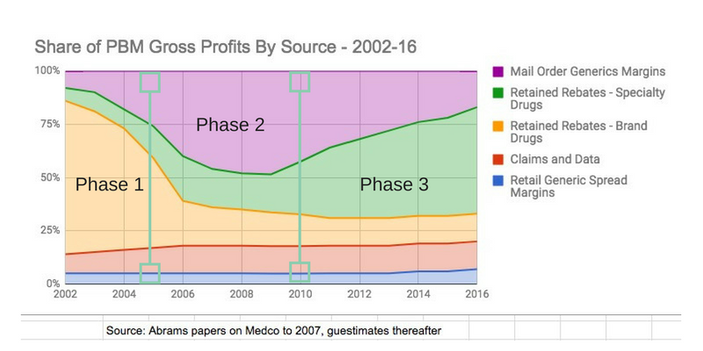
Largest source of PBM Gross Profits

Slide 39
Pharmacy Issues - State Legislation
States with Gag Clause/Clawback Bills
Arizona (HB 2202)
Florida (HB 351/SB 1494)
Kansas (SB 351)
Kentucky (HB 463)
Maryland (HB 1349)
Minnesota (HF 3016/SF 2669/SF 2674)
Missouri (HB 1542)
Mississippi (HB 709)
New Hampshire (HB 1741/1791/SB 354)
New York (A 8781/S 6940)
Ohio (HB 479)
South Carolina (S 815)
Vermont (H 886)
Virginia (awaiting Governor’s signature)
Washington (SB 6026/HB 2296)
Wisconsin (SB 669)
West Virginia (SB 46/HB 4286)
States with PBM Registration Bill
Alaska (HB 240)
Arkansas (SR 9)
Florida (SB 534)
Maryland (HB 1349)
Tennessee (HB 327)
Wisconsin (AB 621/SB 532)

Slide 40
The Accumulator Adjustment Program
What is it?
A utilization management tool that detects the use of co-pay assistance by patients, in order to exclude co-pay assistance as an “out-of-pocket expense” by the patient for the purpose of meeting their deductible or out-of-pocket maximum.

Slide 41
The Accumulator Adjustment Program
A new payer program that goes by many names:
Copay accumulator.
“Coupon Adjustment: Benefit Plan Protection Program” (United Health Care).
“Out-of-Pocket Protection Program” (Express Scripts).
“Variable copayment or out-of-pocket maximum calculation process” (See RI – S 2532).

Slide 42
The CVS Caremark Program
CVS Specialty Copay Card Program
True Accumulation: ensures that only the cost a member personally pays is applied towards their deductible.
Plan Design Optimization: leverages the value of copay cards to enhance program savings by increasing the copay to optimize the value of the manufacturer program.
Source: https://payorsolutions.cvshealth.com/programs-and-services/specialty/specialty-cost-management

Slide 43
Reading Between the Lines
“Deductible Double Dipping”
(Extracting the deductible amounts from both the manufacturer and from the patient)

Slide 44
Part D rule
CMS – states they have the statutory authority to mandatory pass-through manufacturer price concessions and pharmacy price concessions.
CSRO supports 100% pass-through for both. (100% of price concessions being passed through would result in less definitional gaming by the PBMs)
CMS estimates that, with a 100% pass-through of manufacturer rebates, beneficiaries would see a monthly premium increase of $43.84 but see a monthly $131.97 reduction in cost-sharing
The premium increase would be more than offset by the cost-sharing reduction. Overall, over ten years, beneficiaries would save $56.9 billion with a 100% pass-through. Meanwhile, the government would save $82.1 billion. The effect of passing through pharmacy price concessions is similar for beneficiaries, though the numbers may be a bit smaller.

Slide 45
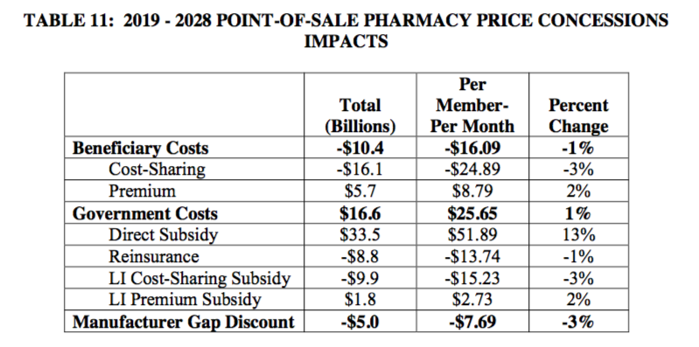

Slide 46
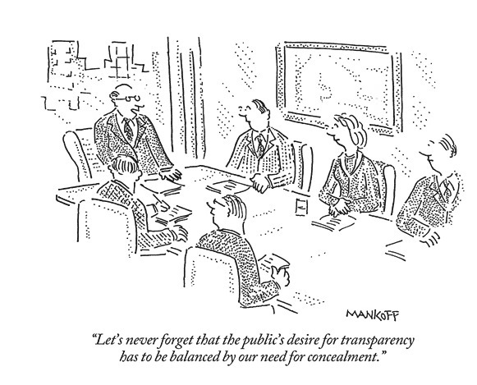
The Transparency Problem
Notes:
Insurers “are sophisticated purchasers who receive full visibility into our approach, and they can audit our pricing and guarantees at any time. By definition, all PBMs are transparent, meaning that they provide their clients with full disclosure to contractually agreed upon pricing terms, rebates and other guarantees.” – Brian Henry, ESI
These positions fail to consider other critical information not included in or relevant to the contract (i.e. amount pharmacies receive for dispensing drug).
(Langreth R. Champion of lower drug prices fights own overcharging allegation. Bloomberg. https://www.bloomberg.com/news/articles/2016-01-14/champion-of-lower-drug-prices-fights-own-overcharging-allegation. January 14, 2016. Accessed January 10, 2017.)

Slide 47
Caregiver Action Network is...
the nation’s leading non-profit organization providing education and resources to family caregivers free of charge.

Slide 48
Who Comes to CAN?
Notes:
POINTS TO MAKE:
PEER SUPPORT
CAN IS THE “WHITE HAT” THAT’S THE ADVANTAGE OF WORKING WITH A NON-PROFIT

Slide 49
Two out of every 5 adults are family caregivers
39% of all adult Americans are caring for a loved one who is sick or disabled – up from 30% in 2010. The average age of caregivers is 49 and nearly 70% of family caregivers are between the ages of 45-64.

Slide 50
It’s not just women doing the caregiving
Men are now almost as likely to say they are family caregivers as women are (37% of men; 40% of women). And 36% of younger Americans between ages 18 and 29 are family caregivers as well, including 1 million young people who care for loved ones with Alzheimer’s.

Slide 51
Most adults would prefer to age in place
90% of adults over the age of 65 would prefer to stay in their current home as they age. Family, friends, and neighbors provide 80% of the care for the elderly.

Slide 52
Complex care happens in the home.
Almost half of family caregivers perform sophisticated medical/nursing tasks for their loved ones – such as providing wound care and operating specialized medical equipment – and up to 70% manage medications for their loved ones.

Slide 53
Family caregivers are the backbone of the Nation’s long-term care system
Family caregivers provide $522 billion worth of unpaid care each year.
That’s more than total Medicaid funding, and twice as much as homecare and nursing home services combined.

Slide 54
www.CaregiverAction.org
I just realized I’m a family caregiver.
I have been a family caregiver for years.
I live far away and I’m on the caregiving team.
I have a job and I’m the caregiver for my loved one.
Notes:
> GO TO CAN’S WEBSITE AFTER THIS SLIDE

Slide 55
Medicare Part D: Recent Developments
Joel White
April 11, 2018

Slide 56
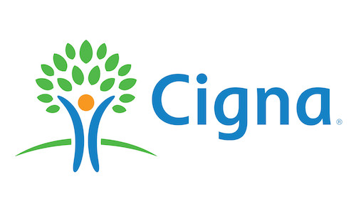
About CAHC
Employer | Payer/Provider | Patient | Biopharmaceutical | Tech/Broker
Notes:
Views are my own. Members across issue campaigns.

Slide 57
The Big Issues
Part D is working well
Some challenges as it matures and Congress makes changes
Opportunities to Work together

Slide 58
Part D Rule and Call Letter
Standard terms and conditions to “any willing pharmacy” – maintain access to small/community based businesses
Implementing lock-in provisions of the Comprehensive Addiction and Recovery Act of 2016 (CARA);
Updating e-prescribing standards for 2020;
Creating additional Part D plan flexibilities to manage formularies – hard edit for opioids to 7 day supply
CMS received 1,400 comments on RFI for POS rebates/DIR price concessions – changes in the future
Notes:
These changes reflect a desire from the administration to address rising gross drug prices and increasing cost sharing for consumers.

Slide 59
What’s Happening With DIR/POS
Price concessions are allowed to be passed on to consumers at the point of sale, but are not required.
All price concessions that are not included in the negotiated price must be reported to CMS as DIR and are used in the calculation of final plan payments, which, under the statute, are required to be based on costs incurred by Part D sponsors, net of all applicable DIR.
As a result, beneficiaries see lower premiums, but they do not benefit from lower cost- sharing.
Experience: Average plan premiums increased 1 percent per year between 2010 and 2015 and is decreasing in 2018 because DIR is increasing faster than growth in drug costs.
Also as a result, beneficiaries are paying higher cost sharing at the point of sale.

Slide 60
DIR/POS Background
Between 2010 and 2015, price concessions received by Part D sponsors increased nearly 24 percent per year, about twice as fast as total Part D gross drug costs
About 65 percent of net price is realized by manufacturers.
35 percent rebated to plans
Applied to premiums, not passed on at point of sale
In 2017 beneficiaries paid 34 percent of a plan’s gross costs, but 42 percent of net costs after rebates
Similar trend for pharmacy price concessions
$127 billion in rebates and discounts paid in 2017 to all payers

Slide 61
CMS RFI
CMS is NOT making any policy changes in this area at this time, but indicated future changes are likely.
CMS lays out several percentages (33, 50, 66, and 100) where plans would give back rebates to consumers at the point of sale.
CMS favors a balance between POS rebates and DIR (minimum rebate at less than 100 percent but greater than zero).
CMS will likely issue a rule in the future on POS/DIR
Notes:
Specifically, CMS is considering requiring, through future rulemaking that Part D sponsors to include in the negotiated price reported to CMS for a covered Part D drug a specified minimum percentage of the cost-weighted average of rebates provided by drug manufacturers for covered Part D drugs in the same therapeutic category or class.

Slide 62
Medicare 101…
Part A
Part B
Federally Administered Coverage
Hospital Insurance
Part A covers Inpatient hospital stays, nursing facility and hospice care; and some home health care.
Medical Insurance
Part B covers doctor visits, outpatient care, medical supplies, preventative services and some prescription drugs
Part C
Part D
Privately Administered Coverage
Medicare Advantage Plans
Private health plans contract with Medicare to provide combined Part A and B benefits as well as additional services such as eye, dental, and prescription coverage.
Prescription Drug Coverage
Created in 2003, Part D covers outpatient prescription medications. These plans are offered by insurance companies and selected by seniors annually in an open marketplace.
Notes:
59 million people
$700
10,000 people enrolling in medicare every day

Slide 63
THANK
YOU
Council for Affordable Health Coverage
440 First Street, NW, Suite 430
Washington, D.C. 20001
(202) 559-0192
Joel.white@cahc.net
Cahc.net
@C4AHC
Notes:
Medicare still faces a substantial financial shortfall that will need to be addressed with further legislation. Such legislation should be enacted sooner rather than later to minimize the impact on beneficiaries, providers, and taxpayers.
That’s your job. Get to work.

Slide 65
50th Annual NCPA Congressional Pharmacy Summit April 12, 2018

Slide 66
Medicaid Panel
Scott Brunner
NCPA Senior Vice President, Communications and State Government Affairs
Vicki Cunningham, RPh
Director of Pharmacy Services, West Virginia Bureau for Medical Services
Delegate Keith Hodges, RPh
Virginia House of Delegates, 98th District
Matt Salo
Executive Director, National Association of Medicaid Directors

Slide 67
Learning Objectives
Discuss key changes that could occur in the Medicaid program in 2018.
Describe potential opportunities for community pharmacy arising from the new Medicaid landscape.
Evaluate how the issues of healthcare could have an effect on the 2018 mid-term elections.

Slide 68
Disclosures
Scott Bruner declares no conflicts of interest or financial interest in any product or service mentioned in this program, including grants, employment, gifts, stock holdings, and honoraria.
Vicki Cunningham declares no conflicts of interest or financial interest in any product or service mentioned in this program, including grants, employment, gifts, stock holdings, and honoraria.
Delegate Keith Hodges declares no conflicts of interest or financial interest in any product or service mentioned in this program, including grants, employment, gifts, stock holdings, and honoraria.
Matt Salo declares no conflicts of interest or financial interest in any product or service mentioned in this program, including grants, employment, gifts, stock holdings, and honoraria.

Slide 69
Outlook for 2018 Midterm Elections
Adam Harbison
NCPA Director of Congressional Affairs
Logan Dobson
Director of Data and Analytics, National Republican Senatorial Committee
Nicole Eynard
Deputy Executive Director, Democratic Congressional Campaign Committee

Slide 70
Disclosures
Adam Harbison declares no conflicts of interest or financial interest in any product or service mentioned in this program, including grants, employment, gifts, stock holdings, and honoraria.
Logan Dobson declares no conflicts of interest or financial interest in any product or service mentioned in this program, including grants, employment, gifts, stock holdings, and honoraria.
Nicole Eynard declares no conflicts of interest or financial interest in any product or service mentioned in this program, including grants, employment, gifts, stock holdings, and honoraria.

Slide 71
NRSC 2018 Senate Preview Logan Dobson Director of Data and Analytics National Republican Senatorial Committee

Slide 72
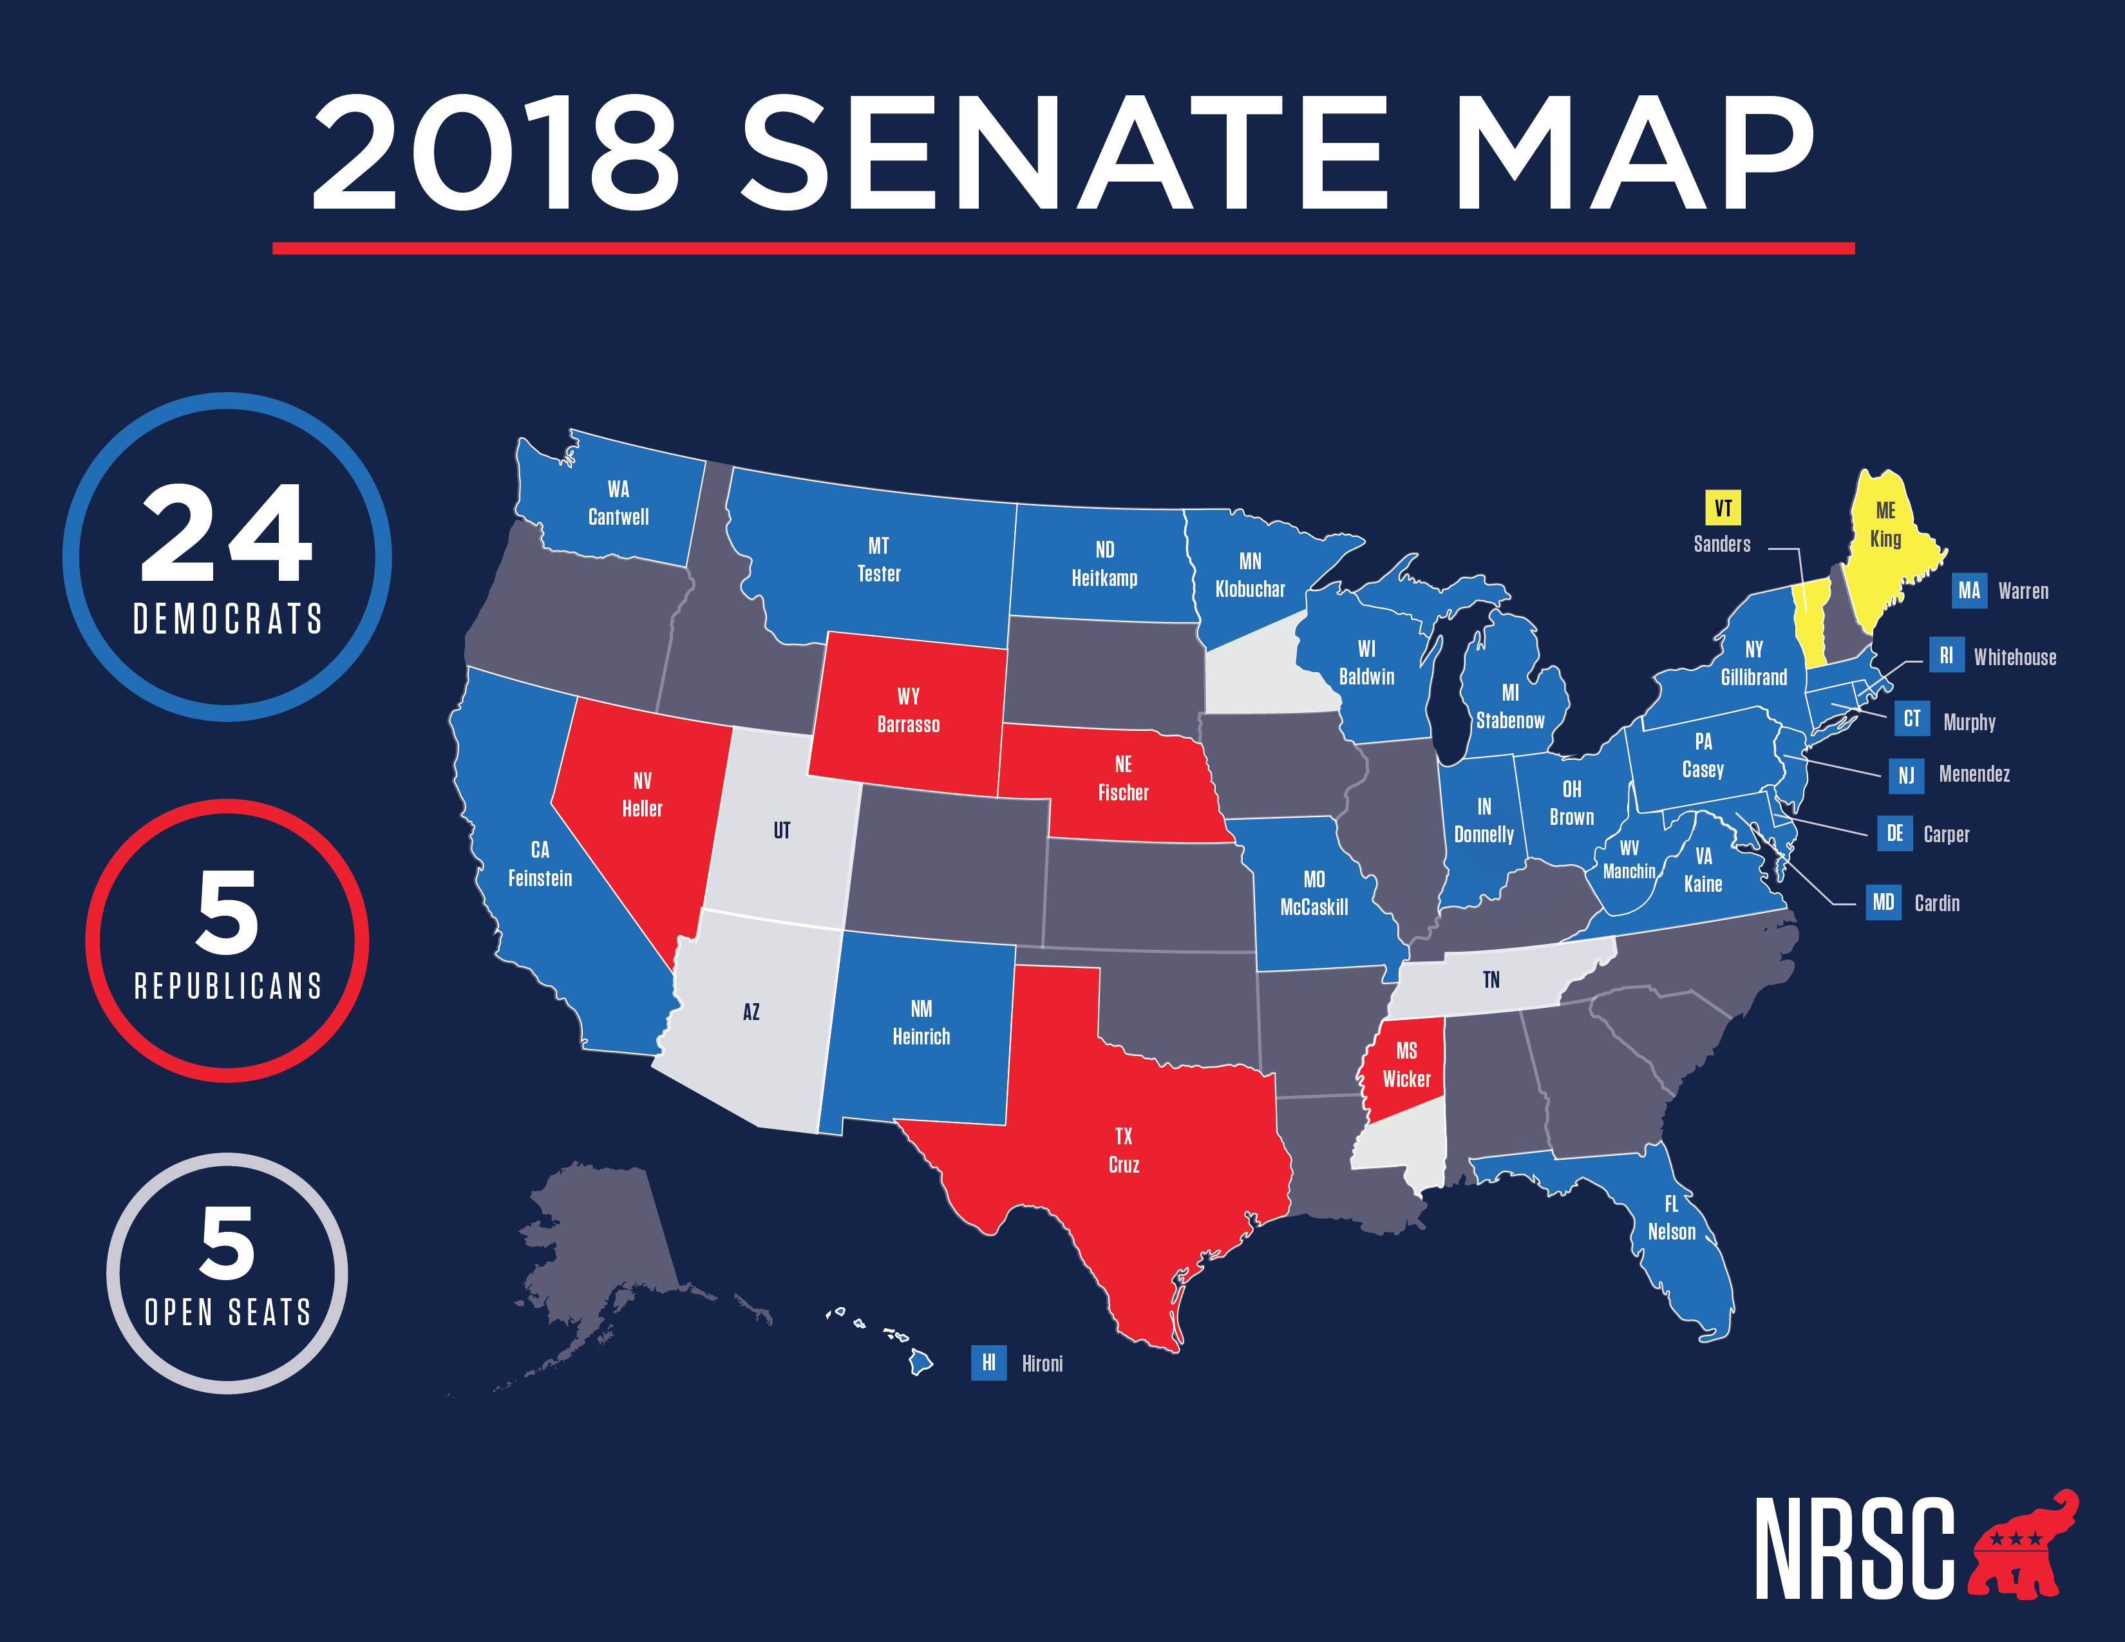

Slide 73
DCCC 2018 Overview Nicole Eynard Deputy Executive Director Democratic Congressional Campaign Committee

Slide 74
BATTLEFIELD
DISTRICTS
AND COUNTING
FRONTLINE
OFFENSE
OPEN

Slide 75
RED-TO-BLUE

Slide 76
OPEN RED-TO-BLUE
AZ-02, ANN KIRKPATRICK
OPEN – MCSALLY
FL-06, NANCY SODERBERG
OPEN – DESANTIS
KS-02, PAUL DAVIS
OPEN – JENKINS
NJ-02, JEFF VAN DREW
OPEN – LOBIONDO
NJ-11, MIKIE SHERRILL
OPEN – FRELINGHUYSEN
NM-02, XOCHITL TORRES SMALL
OPEN – PEARCE
NV-03, SUSIE LEE
OPEN – ROSEN
PA-06, CHRISSY HOULAHAN
OPEN – COSTELLO

Slide 77
FRONTLINE
REP. TOM O'HALLERAN AZ-01
REP. AMI BERA, M.D. CA-07
REP. SALUD CARBAJAL CA-24
REP. JULIA BROWNLEY CA-26
REP. RAUL RUIZ, M.D. CA-36
REP. SCOTT PETERS CA-52
REP. STEPHANIE MURPHY FL-07
REP. CHARLIE CRIST FL-13
REP. DAVE LOEBSACK IA-02
REP. BRAD SCHNEIDER IL-10
REP. CHERI BUSTOS IL-17
REP. ANNIE KUSTER NH-02
REP. JOSH GOTTHEIMER NJ-05
REP. TOM SUOZZI NY-03
REP. SEAN PATRICK MALONEY NY-18
REP. MATT CARTWRIGHT PA-08
REP. CONOR LAMB PA-17

Slide 78
Outlook for 2018 Midterm Elections
Adam Harbison
NCPA Director of Congressional Affairs
Logan Dobson
Director of Data and Analytics, National Republican Senatorial Committee
Nicole Eynard
Deputy Executive Director, Democratic Congressional Campaign Committee

