Slide 1
What are Pharmacy Benefit Managers?

Slide 2
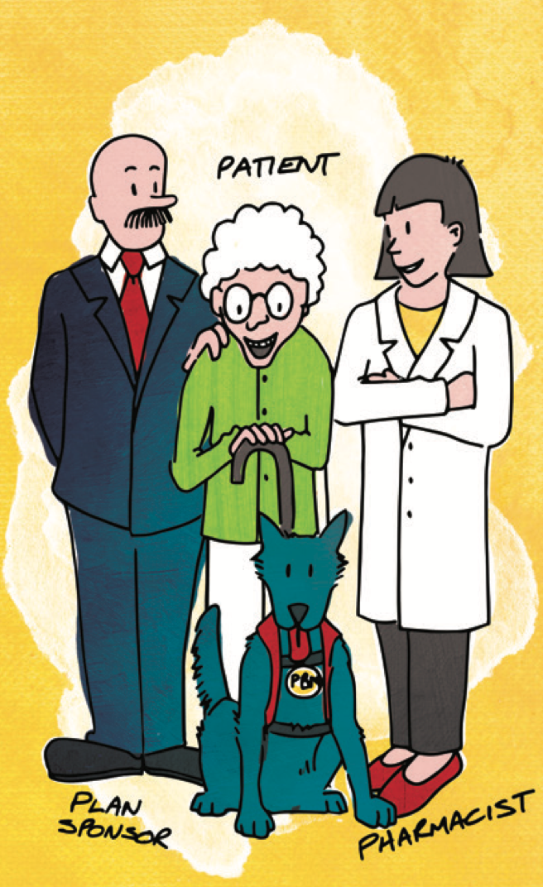
The Creation of Pharmacy Benefit Managers
Decades ago, Insurance companies expanded their coverage to include prescription drugs
Insurance companies turned to Pharmacy Benefit Managers (PBMs) to process prescription drug claims
PBMs, at a small fee, managed claims for
Managed Care Organizations​
Employers​
Government Programs

Slide 3
What is the PBMs main purpose?
Today, PBMs market themselves as the “guard dogs” of cost in the drug supply chain
But that is their story…..

Slide 4
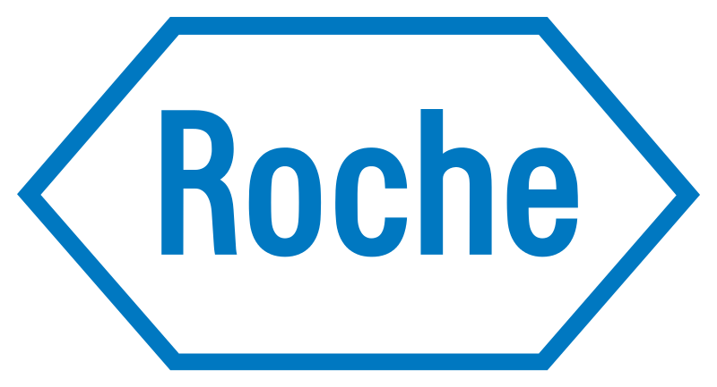
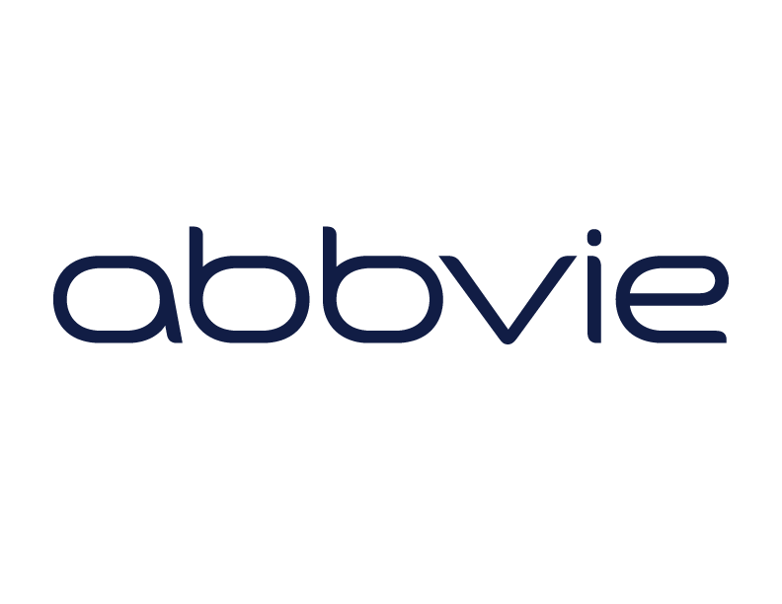
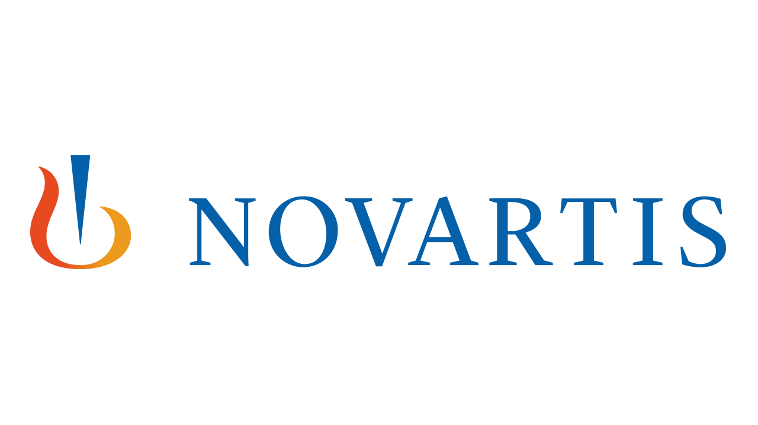
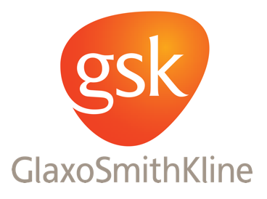
How Pharmacy Benefit Managers Work
PBMs contract with pharmaceutical manufacturers to obtain favorable pricing

Slide 5
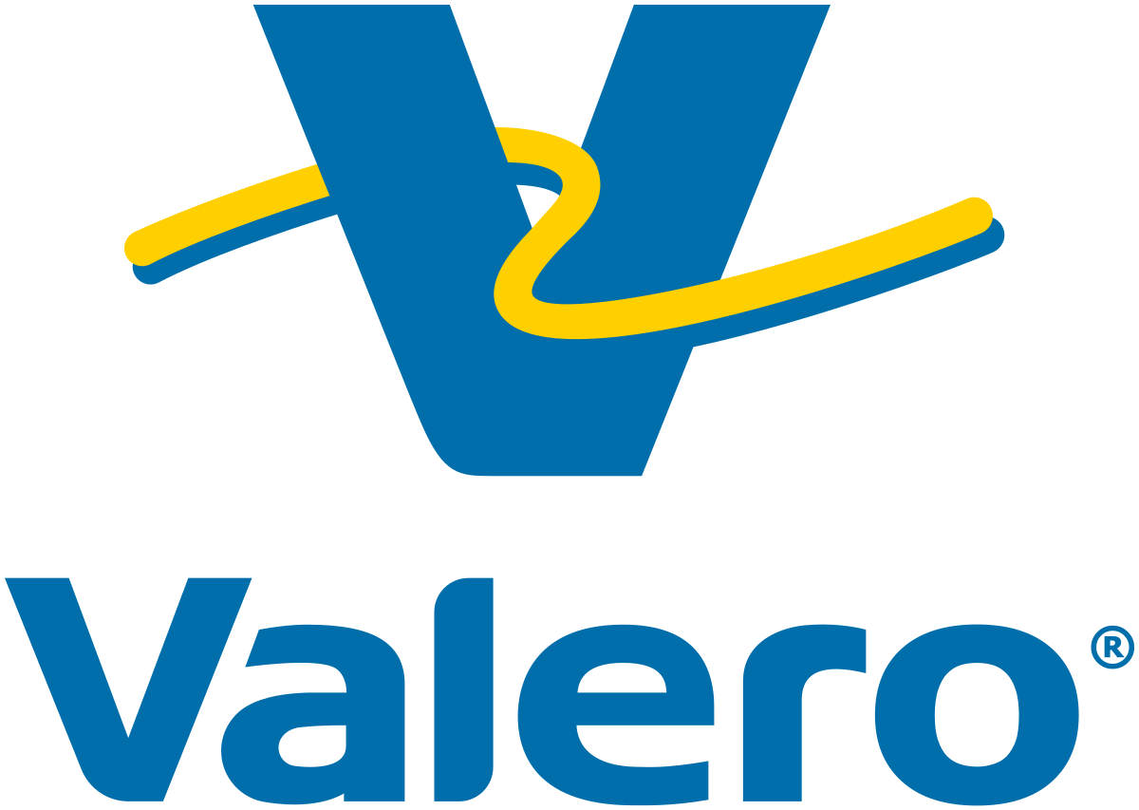
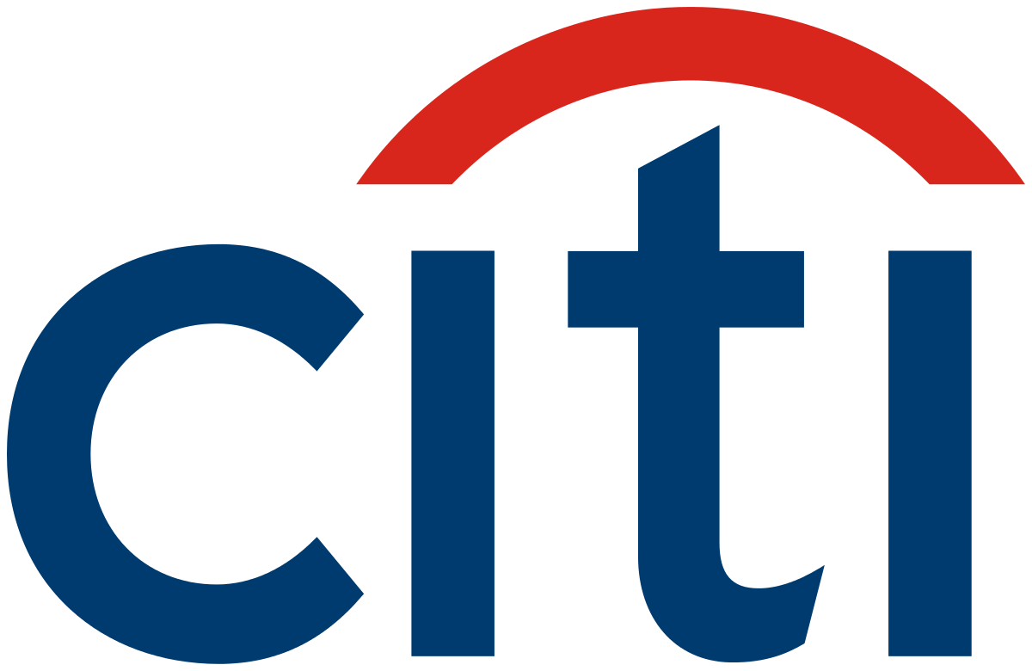
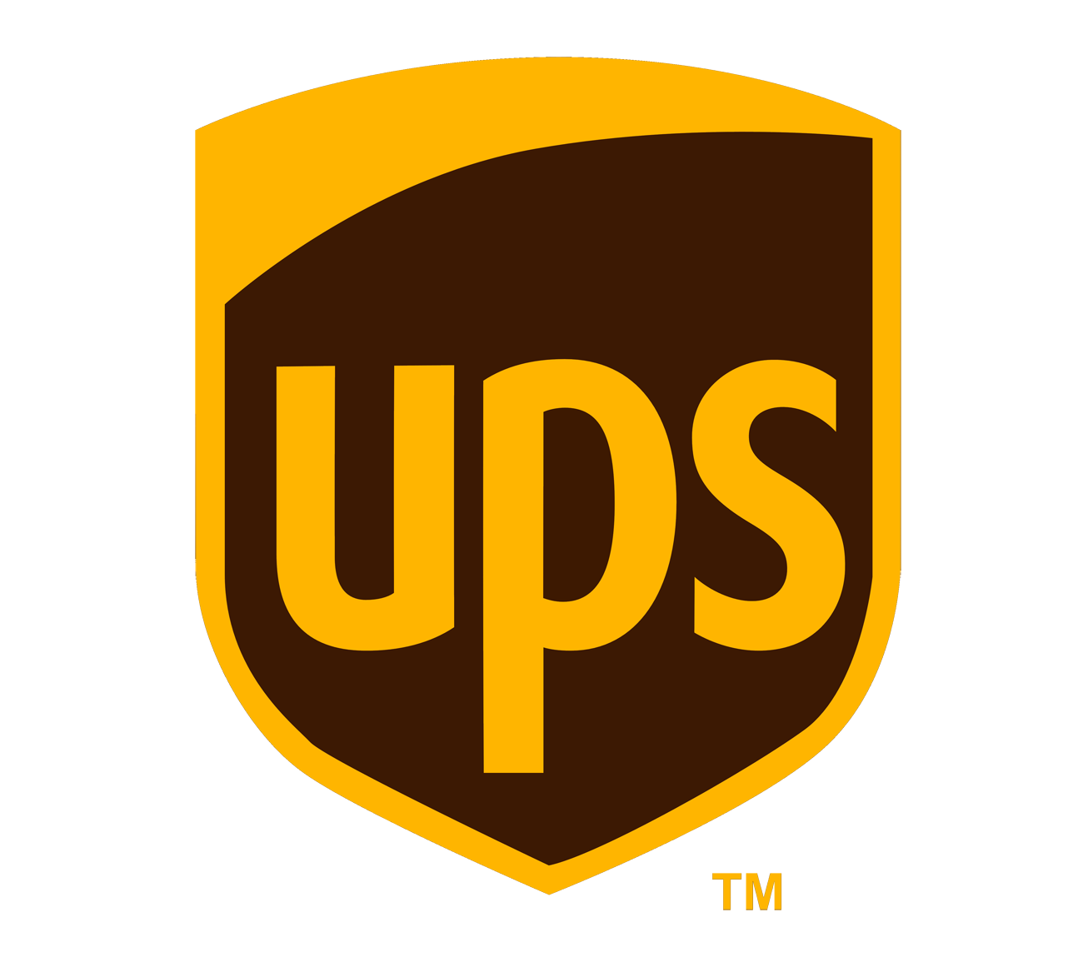
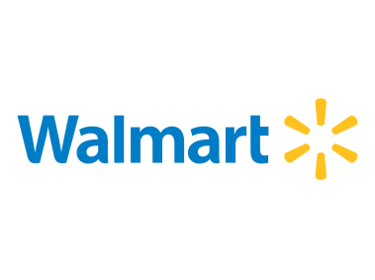
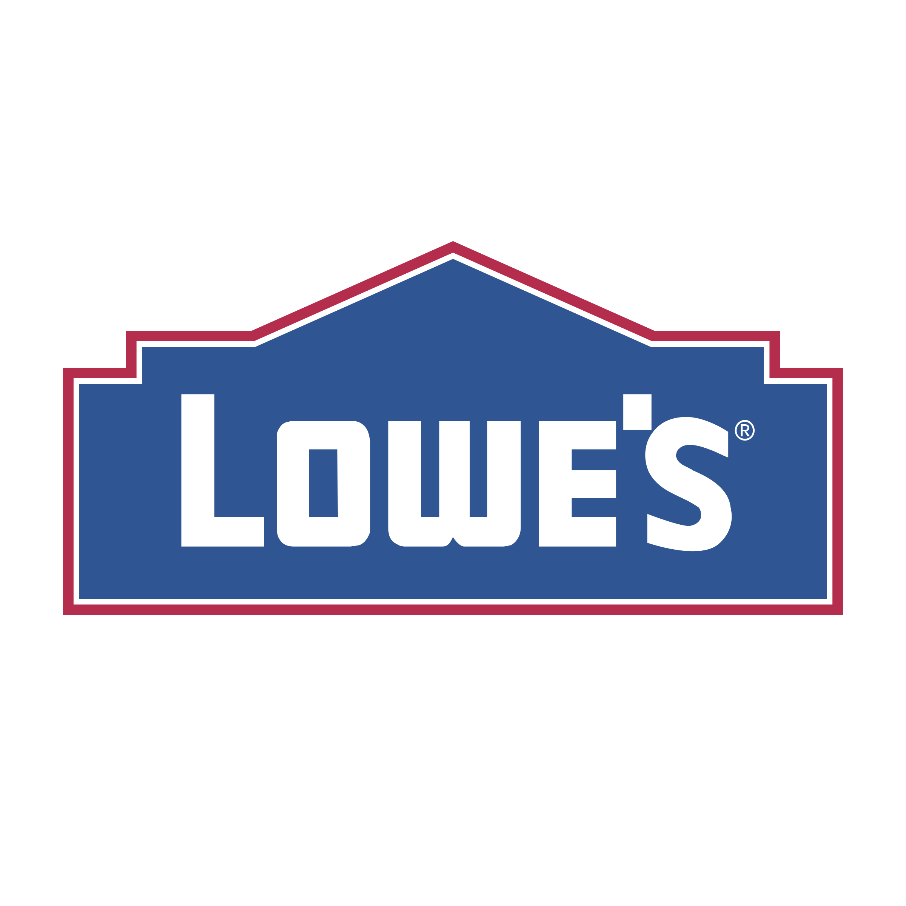
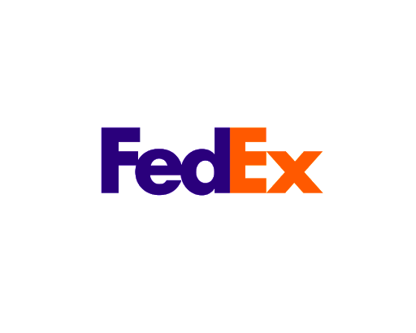
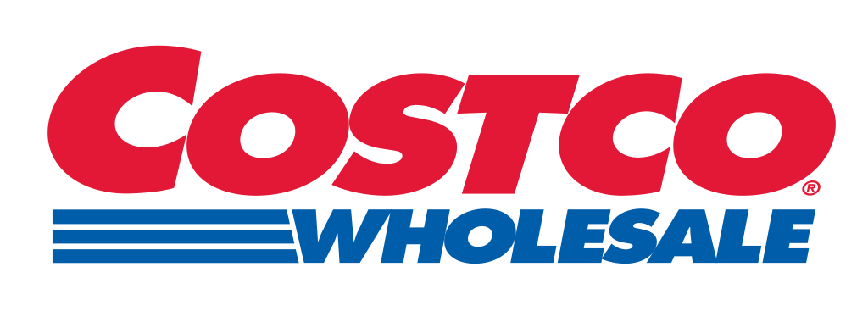
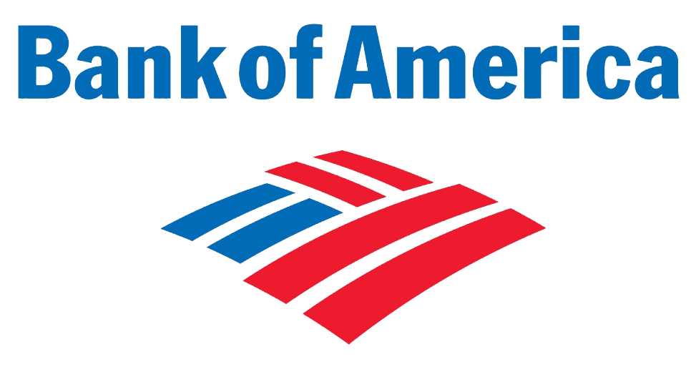
How Pharmacy Benefit Managers Work
Employers/insurers sign 1-3 year contracts with PBMs to “manage” the prescription drug plans provided to their members and employees
PBMs determine which pharmacies will be included in a prescription drug plan’s network and how much those pharmacies will be paid for their services

Slide 6
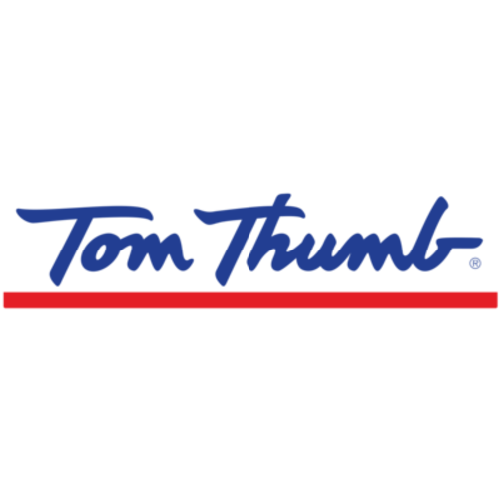
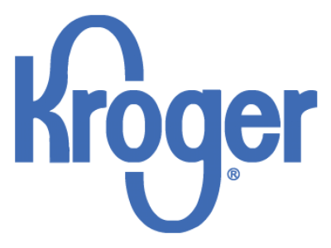
How Pharmacy Benefit Managers Work
PBM Pharmacy Networks are comprised of various types of pharmacies
Independent Pharmacies
Regional Chains
National Chains
Grocery Stores
Some PBMs incentivize plan sponsors to require plan beneficiaries to use certain mail order pharmacies or retail pharmacies
These are often one owned and operated by the PBM

Slide 7
How PBMs are positioned
PBMs
Pharmacy
Employer/Insurer
PBM verifies patient eligibility and sends back to pharmacy payment information
Pharmacist fills prescription(s) and electronically submits claim to the PBM
PBM has placed itself in the middle of all communication between the employer/insurer and the pharmacy provider
PBM bills employer/insurer for prescription(s) filled for their beneficiary

Slide 8
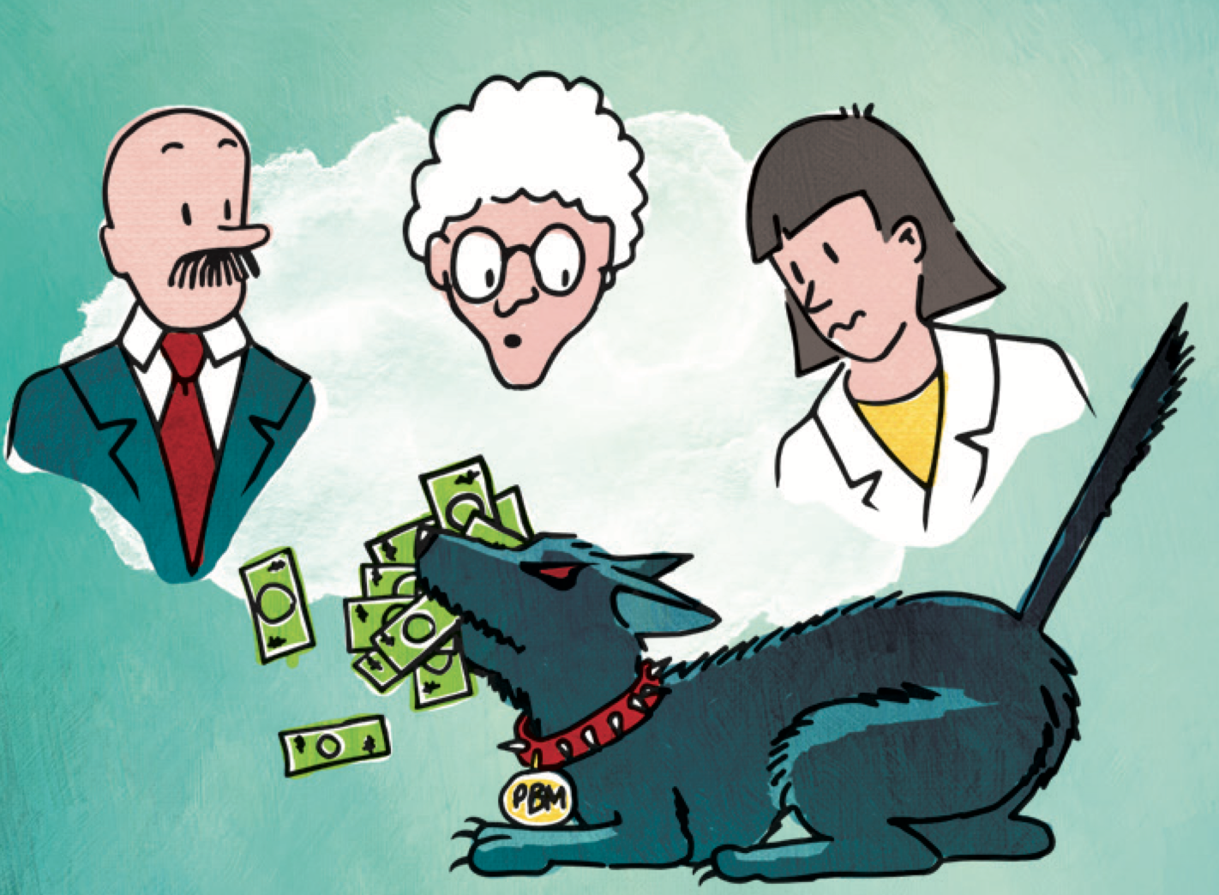
What is the truth?
Meet Phil MyPockets
Over time, these companies have become largely unrecognized by most employees and misunderstood by many employers and payors (including governmental entities)
PBMs have had a tremendous impact on
U.S. health care decision-making
Drug cost
Ultimately, they pursue profits at the expense of quality patient care

Slide 9
PBMs make money from almost every player in the prescription supply chain,​ including the patient…​ yet they never touch a medication.

Slide 10
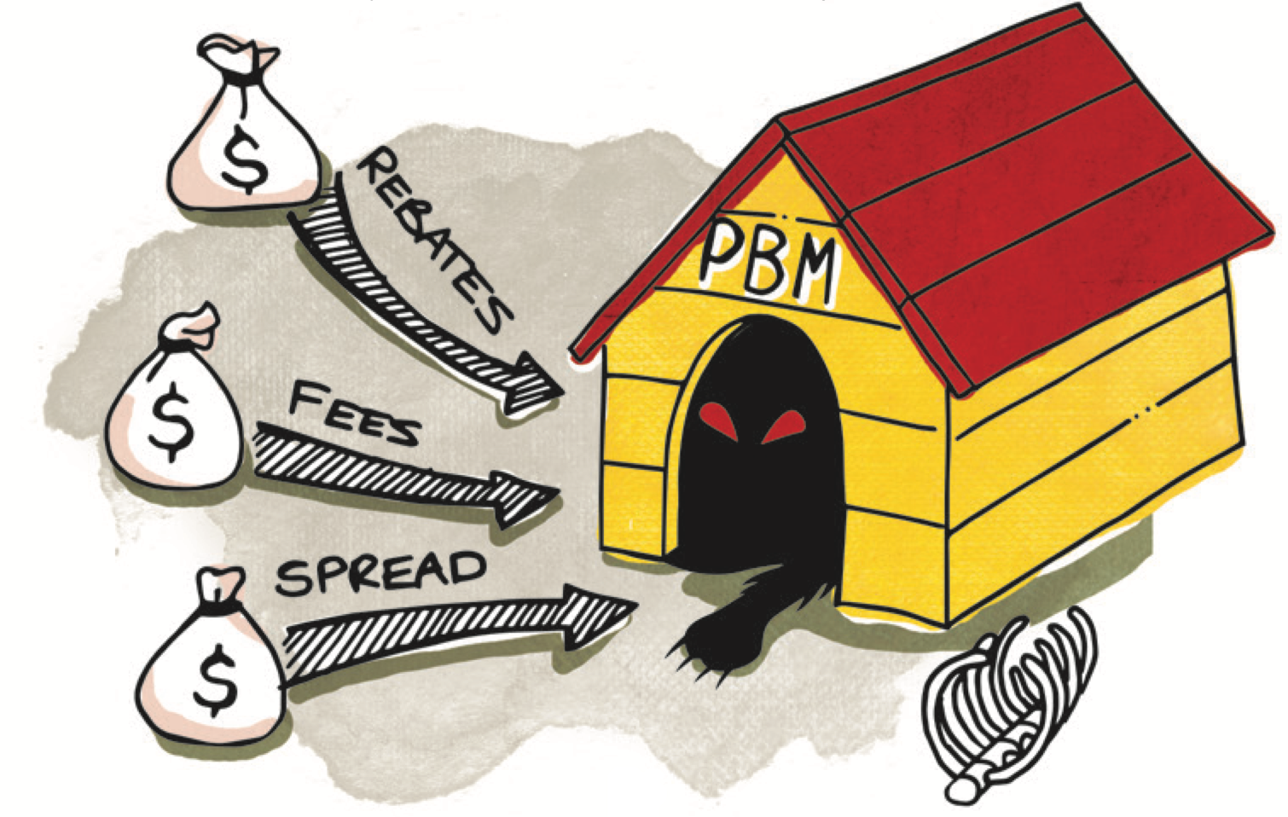
PBM Practices Skyrocket Consumer Costs
There are numerous methods PBMs drive up drug spending and impact U.S. health care decision-making
Network Issues
Patient Issues
Pharmacy Anti-competitiveness
Reimbursement Issues
Coercive Contracting
Fraud, Waste and Abuse
Usually, PBMs have no fiduciary duty to anyone but their shareholders​
Not to patients​
Not to health plans / plan sponsors​
Not to the state

Slide 11
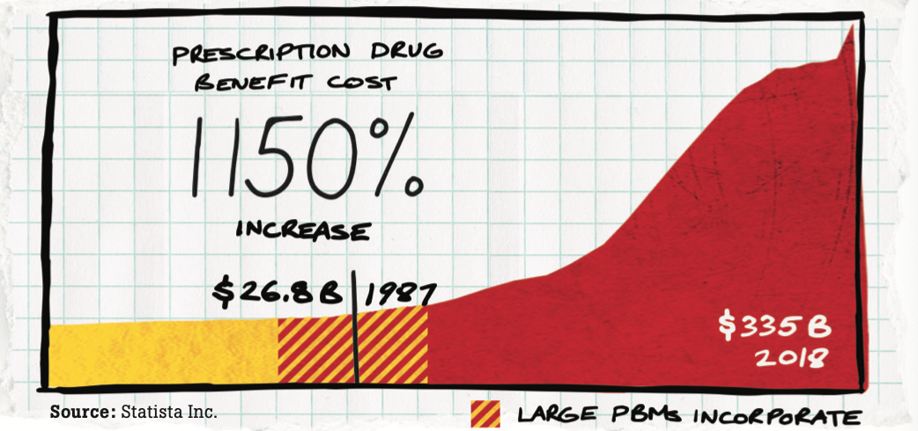
Here are some real numbers
Since 1987, total spending on prescription drugs in the U.S. has increased 1,129 percent, from $26.8B to $335B. Overall price inflation in the U.S. only grew 125.9 percent in that same period.

Slide 12
Network Issues
PBMs affects pharmacies and patients through preferred/restrictive networks and mandated use of PBM affiliated retail, mail-order, or specialty pharmacies.

Slide 13
Network Issues
Preferred/Restrictive Networks
Community pharmacies that are willing to accept the same terms and conditions of other pharmacies in the network are prohibited from the network
Mandatory use of PBM owned or affiliated pharmacy
PBMs may require patients to fill certain prescriptions at their own retail, mail order, or specialty pharmacy
The purpose is to drive patients, regardless of their choice, to PBM owned or affiliated pharmacies

Slide 14
Patient Issues
PBM practices, like inflexible prior authorization requirements and DIR/Retroactive claim adjustments all directly affect the patient’s health and wallet.
Patients are often unaware of these hurdles affecting their care

Slide 15
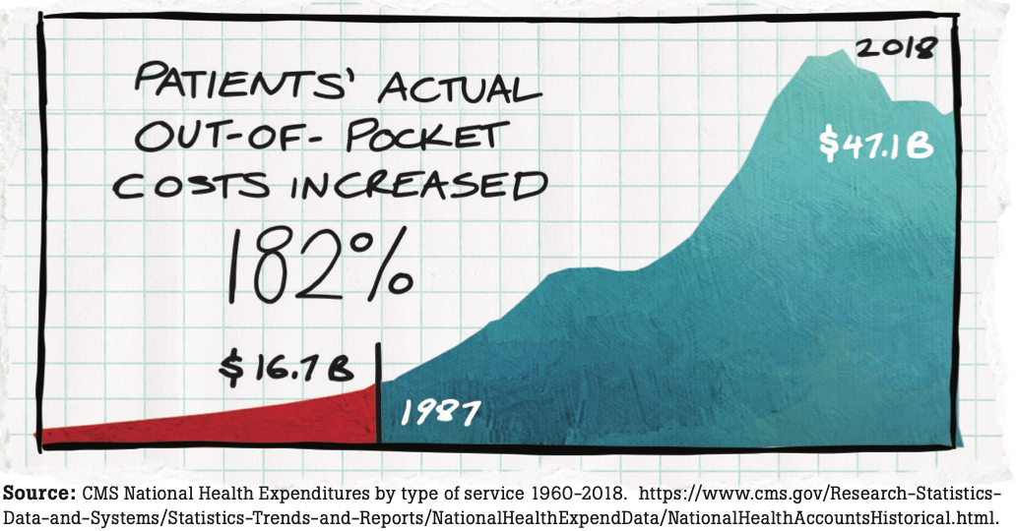
Direct Patient Impact
PBMs point out that patients’ out-of-pocket expenses (copays, etc.) as a percentage of total prescription drug spend have been falling for decades
That’s misleading, because total drug spend in dollars has risen precipitously in the same period
The amount of money consumers themselves are paying for prescriptions has grown, not fallen. Indeed, actual patient out-of-pocket costs have increased 182 percent since 1987

Slide 16
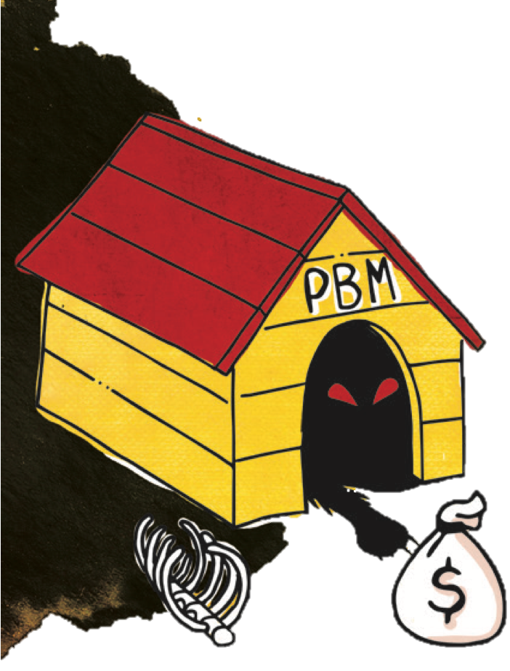
Direct Patient Impact
“DIR” or Direct and Indirect Remuneration
PBMs “claw back” pharmacy reimbursements
Patients pay a copay based on the reimbursement, but their copay is not based on the lowest payment to the pharmacy

Slide 17
How Pharmacy DIR Fees Work

Slide 18
How Pharmacy DIR Fees Work

Slide 19
How Pharmacy DIR Fees Work

Slide 20
How Pharmacy DIR Fees Work

Slide 21
Indirect Patient Impact
Pharmacies are forced to close, limiting convenient access to local pharmacist providers
Between
2010 and 2018
the number of
INDEPENDENT PHARMACIES
declined by
1,297 stores
or roughly 6%
630 rural communities nationwide that had at least
1 RETAIL PHARMACY
in 2003
had ZERO
retail pharmacies in 2018

Slide 22
How DIR Fees Hurt Medicare Patients & Taxpayers

Slide 23
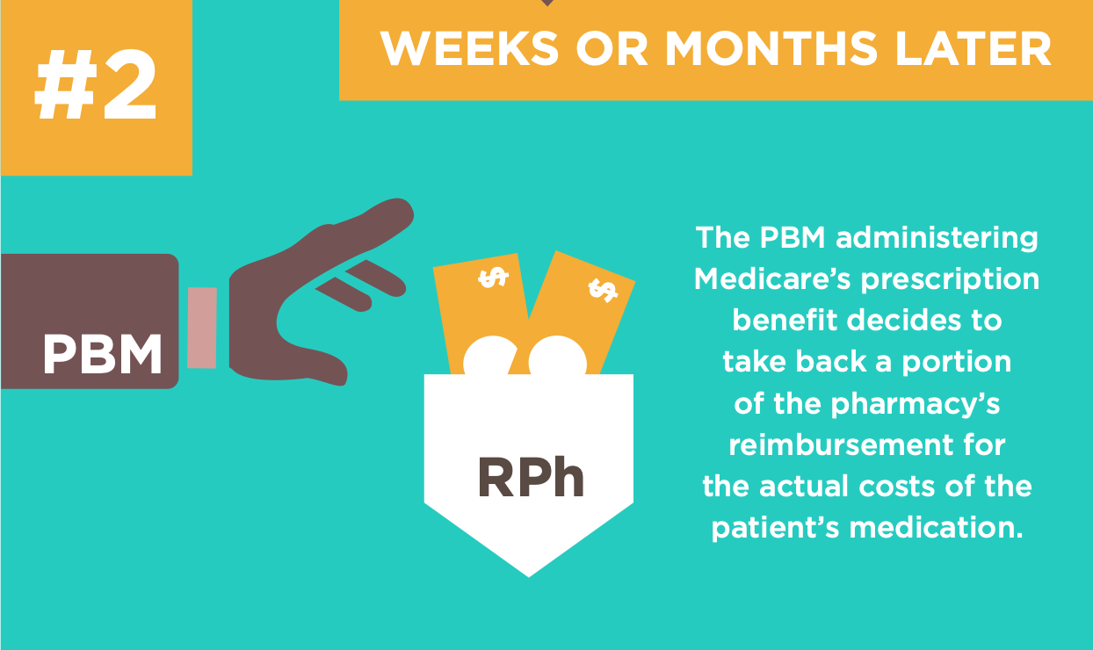
How DIR Fees Hurt Medicare Patients & Taxpayers

Slide 24
How DIR Fees Hurt Medicare Patients & Taxpayers

Slide 25
How DIR Fees Hurt Medicare Patients & Taxpayers

Slide 26
Pharmacy Anti-competitiveness
PBMs are direct competitors of community pharmacies, yet they get to determine how these pharmacies operate.
A system allowing dominant companies to dictate such terms to their smaller competitors is anti-competitive on its face.

Slide 27
Pharmacy Anti-competitiveness
PBMs determine
Networks pharmacies operate in
Types of medications dispensed
Duration of the supply dispensed
How much pharmacies will get paid

Slide 28
Pharmacy Anti-competitiveness
Anti-competitiveness has been exacerbated by the consolidation in the industry due to
Vertical integration (e.g. CVS acquiring Aetna; Cigna buying Express Scripts)
Horizontal integration (i.e. merger of large PBMs such as the 2012 merger of Express Scripts and Medco)
The ultimate purpose of these practices is to drive patients and revenue to their own pharmacies

Slide 29
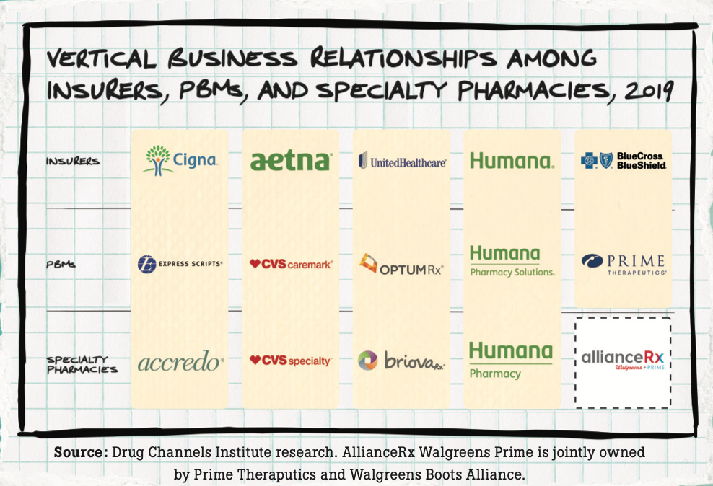
Vertical Integration

Slide 30
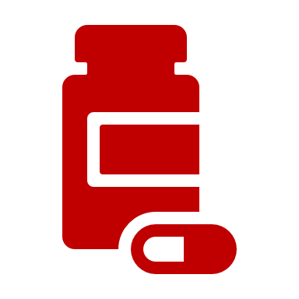
Insurer: Aetna (CVS Health)
Drug Manufacturer
PBM: Caremark
(CVS Health)
Pharmacy: CVS (CVS Health)
Patient

Slide 31
Pharmacy Anti-competitiveness
As of 2017
PBMs control the pharmacy benefits
of more than
266 MILLION
Americans.
Just 3 PBMs
-Express Scripts, CVS Caremark, Optum-
CONTROL …… ….
AS MUCH AS…….…..
of prescription drug benefit transactions in the U.S.¹
76%
1. https://www.drugchannels.net/2019/05/cvs-express-scripts-and-evolution-of.html

Slide 32
Reimbursement Issues
These issues remain the biggest threat to community pharmacy viability, thus one of the biggest threats to patient access.

Slide 33
Reimbursement Issues
Two largest problems
Underwater reimbursement
Non-transparent and outdated MAC lists (which reimbursements in most health plans and programs are based)
Pharmacies are constantly reimbursed below drug acquisition cost and the cost to dispense regardless of the health plan or program

Slide 34
Coercive Contracting
Because pharmacies have essentially no leverage when “negotiating” a contract with PBMs they are usually forced to accept all contract terms-even those terms that are unfair and arbitrary.

Slide 35
Coercive Contracting
Many PBMs are superseding state boards of pharmacy
More stringent accreditation
Certification requirements on pharmacies
Prohibition of community pharmacy delivery services
Arbitration clauses
Prohibition of 90-day fills
These decisions encroach and undermine the domain of the state board of pharmacy

Slide 36
Coercive Contracting
“Take it or leave it” contracts
Pharmacies have essentially no leverage when “negotiating” a contract with PBMs
Usually forced to accept all contract terms-even those terms that are unfair and arbitrary
PBMs make sudden changes and amendments to these contracts
A pharmacy cannot refuse a contract when potentially 30-50% of their patients would be covered by the contract
Restricts patient access to otherwise qualified pharmacists

Slide 37
Fraud, Waste and Abuse
Not only do opaque PBM practices negatively impact patients and community pharmacies, but they also contribute to ever-increasing prescription drug costs for plan sponsors and taxpayers.

Slide 38
Fraud, Waste and Abuse
PBM “claw backs”
Patients are not compensated for overpayment of copays after they have clawed back pharmacy reimbursements
PBM “spread pricing”
Employers/insurers are charged an amount greater than the pharmacy was paid for the same drug
The difference is pocketed by the PBM as a source of revenue
PBM “rebates”
PBMs accept money from drug manufacturers in return for placing brand drugs in the “preferred” formulary tier
Mail Order Pharmacy
Patients are mandated to use mail order, while PBMs continue to send medications and other medical supplies that far exceed the patient’s need

Slide 39
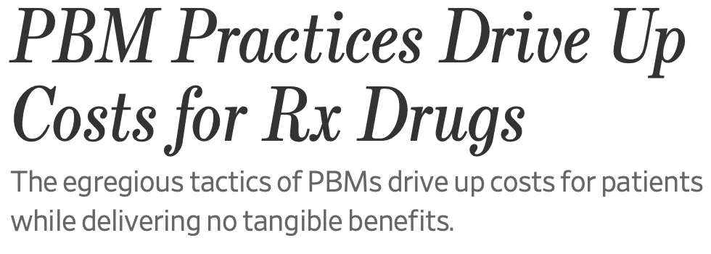
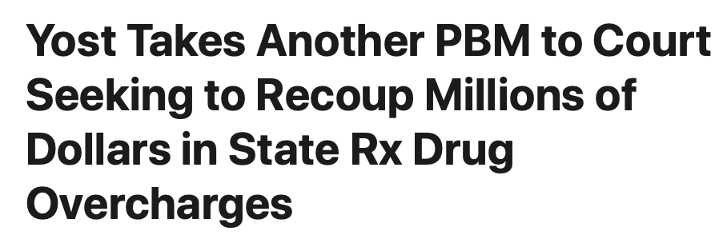
From the Headlines…
CVS Caremark Corp. to Pay $36.7 Million to U.S., 23 States, & D.C. to Settle Medicaid Prescription Drug Fraud Allegations
Medco to Pay U.S. $155 Million to Settle False Claims Act Cases

Slide 40
Recommended Solutions
Use a transparent PBM​
Beware of PBMs that offer transparent and non-transparent models​
Insist on a “Generics First” savings strategy​
Demand that PBMs offer a “dollar-for-dollar” guarantee on any savings claims – especially on savings related to mail utilization​
Use a benefits consultant with experience in negotiating transparent PBM contracts.​
Ask your local pharmacist which PBMs treat them fairly.
​
Call your state or national pharmacist association for assistance in asking the PBM the right questions

Slide 41
Recommended Solutions
Require an adequate network of retail pharmacies
Limited networks can lead to loss of access for patients or higher costs for plan sponsors because PBMs will reimburse their own mail order and affiliate pharmacies at a higher rate than other pharmacies
Utilize a PBA instead of a PBM to administer plans
PBAs handle administrative services for the plan sponsor, such as claims processing and data reporting
The plan sponsor handles other functions such as formular management, rebate negotiations and contracting with pharmacies for network participations

